Slide 1
CS688: Large-Scale Image & Video Retrieval
Memory vectors for similarity search in high-dimensional spaces
Changho Jo
(조창호)
Notes:
1

Slide 2
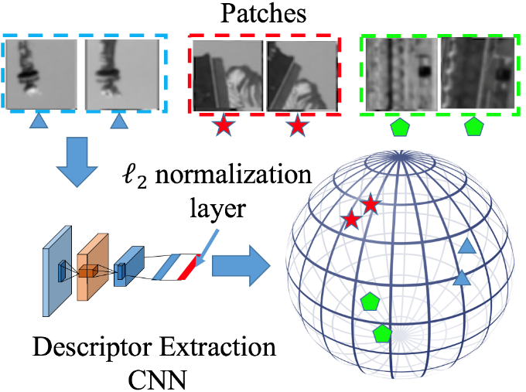
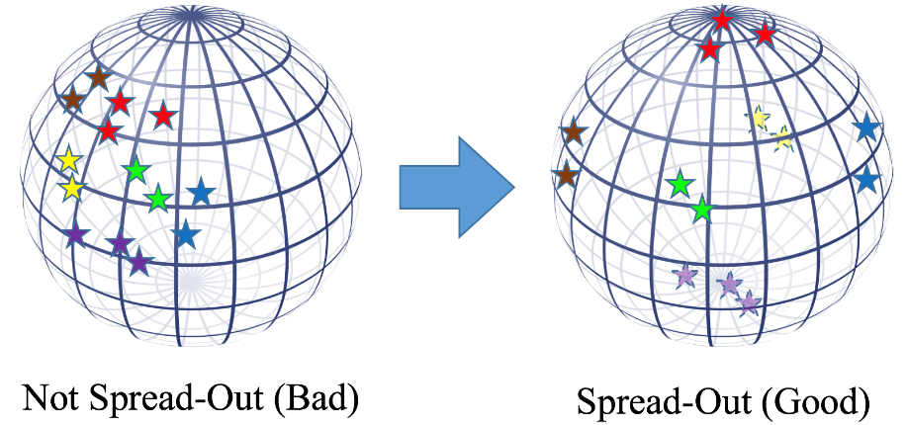
Object of today’s talk
Actually, I was going to present the paper “Learning Spread-out Local Feature Descriptors”(ICCV 2017, X. Zhang)
It learns to spread out all the points in the descriptor space so that the network fully utilize the descriptor space(searching will be more easier)

Slide 3
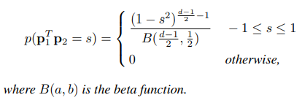
Object of today’s talk
But I found that concept of “pinv” is actually same as the “spread-out”
“Pseudo-inverse” & “Spreading-out”
||m|| = 1

Slide 4
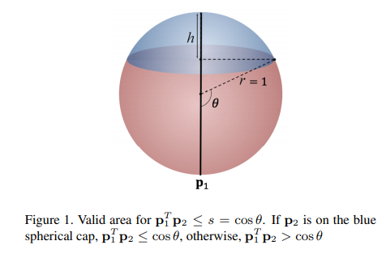
Object of today’s talk
And their analysis are exactly same.
So the message of two papers are intrinsically same.

Slide 5
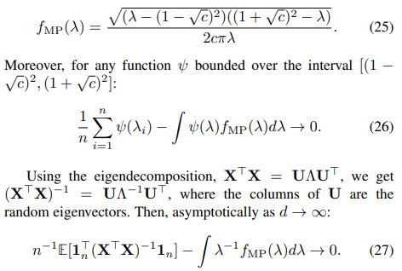
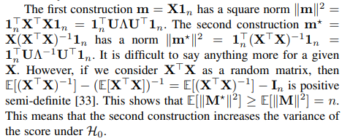
Object of today’s talk
My object here is
Explaining why they introduced pseudo inverse vector(in image search)
Confirming with results
And not
Algebra like this

Slide 6
Recall
When they[1] aggregates each vector of perspective images
They used
Sum vector
Pinv vector
descriptor([x1, x2, ..., xn]): SIFT+NetVlad
Notes:
In more detail, it constructs united vector by summing the global descriptor vectors or pseudo inversing the global descriptor vectors. also they tried explicit panorama construction by creating a panorama image from perspective images and extract a descriptor from the panorama.

Slide 7
Recall
Why they used it?
Fewer comparison (=less runtime)
We also use the representative vectors in DB side. So we only compare 24*24 less vectors.
24 queries
1 query
Notes:
In more detail, it constructs united vector by summing the global descriptor vectors or pseudo inversing the global descriptor vectors. also they tried explicit panorama construction by creating a panorama image from perspective images and extract a descriptor from the panorama.

Slide 8
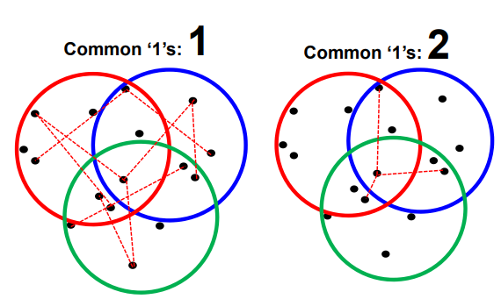
Previous works
Dimension reduction of each features
image descriptors -> bits (or smaller descriptors)
Spherical hashing, product quantization, inverted multi index
https://sgvr.kaist.ac.kr/~sungeui/IR/Slides/Lec6-Hashing.pdf
Notes:
In more detail, it constructs united vector by summing the global descriptor vectors or pseudo inversing the global descriptor vectors. also they tried explicit panorama construction by creating a panorama image from perspective images and extract a descriptor from the panorama.

Slide 9
Previous works
Aggregate local features
VLAD(Vector of locally aggregated descriptors), BOW, FV
https://sgvr.kaist.ac.kr/~sungeui/IR/Slides/Lec6-Hashing.pdf
Notes:
In more detail, it constructs united vector by summing the global descriptor vectors or pseudo inversing the global descriptor vectors. also they tried explicit panorama construction by creating a panorama image from perspective images and extract a descriptor from the panorama.

Slide 10
Previous works
Aggregate local features
VLAD(Vector of locally aggregated descriptors), BOW, FV
Authors arguing that “pinv” is different because
Not local features -> global, global feature -> group
No semantic meanings like them
Keep the same descriptor dimension(Not something like d: 1024-> 256)
Notes:
In more detail, it constructs united vector by summing the global descriptor vectors or pseudo inversing the global descriptor vectors. also they tried explicit panorama construction by creating a panorama image from perspective images and extract a descriptor from the panorama.

Slide 11
Before the journey
KEY IDEA: You should remember that purpose of “pinv” is same as making the variance bigger.
here the variance means variance of descriptors
Learning Spread-out Local Feature Descriptors, ICCV 2017, X. Zhang
Notes:
In more detail, it constructs united vector by summing the global descriptor vectors or pseudo inversing the global descriptor vectors. also they tried explicit panorama construction by creating a panorama image from perspective images and extract a descriptor from the panorama.

Slide 12
Before the journey
You should not that descriptors are already calculated
Ex) we can think red stars as M1, yellow stars as M2, and so on...
Learning Spread-out Local Feature Descriptors, ICCV 2017, X. Zhang
Notes:
In more detail, it constructs united vector by summing the global descriptor vectors or pseudo inversing the global descriptor vectors. also they tried explicit panorama construction by creating a panorama image from perspective images and extract a descriptor from the panorama.

Slide 13
Before the journey
I will start from sum vector, because it gives motivation to apply pseudo-inverse
Before we move on, we need some definitions
Notes:
In more detail, it constructs united vector by summing the global descriptor vectors or pseudo inversing the global descriptor vectors. also they tried explicit panorama construction by creating a panorama image from perspective images and extract a descriptor from the panorama.

Slide 14
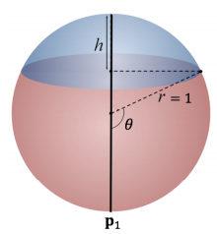
Problem formulation
We have memory unit X={x1, x2, ..., xn}
xi = d dimensional vector
We also have query vector y
||xi|| = 1, ||y|| = 1
vectors xi are IID samples from a uniform distribution on the d-dimensional unit hypersphere.
How many comparison needed for naive approach?
Learning Spread-out Local Feature Descriptors, ICCV 2017, X. Zhang
Notes:
In more detail, it constructs united vector by summing the global descriptor vectors or pseudo inversing the global descriptor vectors. also they tried explicit panorama construction by creating a panorama image from perspective images and extract a descriptor from the panorama.

Slide 15
Problem formulation
We measure similarity by inner product ${x_{i}}^{T}y$
And we want to find one $x_{i}$ which is “most similar” to $y$ for human, but it is ambiguous
So instead, we find all $x_{i}$ which satisfy ${x_{i}}^{T}y ≥ α_{0}$
Can u guess $α_{0}$ on this
(hyper)sphere?
query
$$α_{0}$$
Learning Spread-out Local Feature Descriptors, ICCV 2017, X. Zhang

Slide 16
IDEA
For a sum memory vector
Now we will solve $Variation of m^{T}y ≥ α_{0}$
$α_{0}$ is just a parameter; let’s ignore it as now
You are ready to solve, but I’ll show only hypothesis because the algebra takes lots of time

Slide 17
Variation of descriptors
Hypothesis0: Y is not related to any vector in X(uniformly distributed)
TL;DR: (variation) =
Hypothesis1: Y is related to one vector in X(Y = αx1 + βZ, Z is a random vector orthogonal to x1 and ||z||=1)
TL;DR: (variation) =

Slide 18
Variation of descriptors
(variation) = or
You should note that we cannot control d(we cannot control curse of dimension)
But you can control ||m||, So the answer is ||m|| = 0?
Then memory vectors are destroyed..

Slide 19
Variation of descriptors
(variation) = or
Constraints
where $1_{n}$ is the length-n vector with all entries equal to 1
It gives minimum ||m||
It gives direction of m(average of X or X’)

Slide 20
Variation of descriptors
minimizing s.t.
The solution is pseudo-inverse!
sol
Since we are only considering high d
And it becomes minimizer of
if no solution exists => linear regression problem!

Slide 21
Variation of descriptors
Also you can see the α0 as last constraint.
In other words, we find calculated memory vectors which is enough(α0) close to the query vector.
small α0 => need to compare lots of memory vectors
too large α0 => there’s no
memory vector to compare
query
$$α_{0}$$
Learning Spread-out Local Feature Descriptors, ICCV 2017, X. Zhang

Slide 22
Variation of descriptors
Explaining why they introduced pseudo inverse vector
It maximize variation while we have some constraints, so that we can spread out the memory vectors
Confirming with results

Slide 23
Results
Experiment setting
Dataset: Inria Holidays, Oxford5k, UKB, Holidays+Flickr1M, Yahoo100M
Descriptor: triangular embedding descriptor[1](I don’t know either in detail, SOTA at 2017), VLAD descriptor
d=8064 for triangular embedding, d=1024 for VLAD
Another details need again algebra.
[1]H. Jegou and A. Zisserman, “Triangulation embedding and democratic ´ kernels for image search,” in CVPR, June 2014.

Slide 24
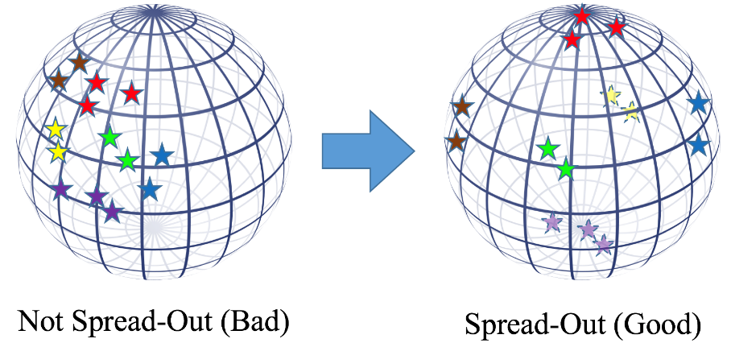
Results
In case the dataset have label: used it
Otherwise
Random assignment: they grouped N vectors to M units of n vectors randomly
Ex) red stars: n=3, total M=6, total N=14
Learning Spread-out Local Feature Descriptors, ICCV 2017, X. Zhang

Slide 25
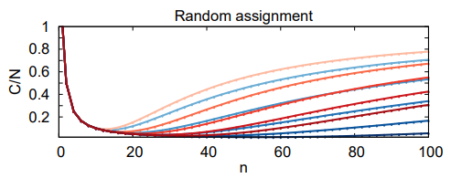
Results
Random assignment: they grouped N vectors to M units of n vectors randomly
vertical axis: cost(memory) / cost(naive)
horizontal axis: n
Red: sum, Blue: pinv
darker color: higher α0(0.5, 0.6, ..., 0.9)

Slide 26
Results
ROC curves
Test performs better when α0 is closer to 1
Do you understand what two results mean?

Slide 27
Summary
Explaining why they introduced pseudo inverse vector
It maximize variation while we have some constraints, so that we can spread out the memory vectors
Confirming with results
Num of Comparison
Higher α0 => less comparison
Pinv needs less comparison then Sum because the property of “spreading-out”
Notes:
So in summary, they contributed by approaching ~

Slide 28
Summary
Contribution
Very algebraic approach of the paper “Learning Spread-out Local Feature Descriptors”(ICCV 2017, X. Zhang)
Notes:
suspicious
#beyond summary, the last remaining feelings that this paper gives to me was like
#I don’t know whether it works in real world but I feel like it’s worth to try this idea also in industry.

Slide 29
Quiz
What is the maximum angle between memory vector(m) and descriptor vectors(X)?
arccos(α0)
No limit
90$°$
query
$$α_{0}$$
Learning Spread-out Local Feature Descriptors, ICCV 2017, X. Zhang

Slide 30
Quiz
Let’s say we did random assignment.
Random assignment: they grouped N vectors to M units of n vectors randomly
We have
M =10
n = 5
(percentage that one of the memory vectors found by query) = 60%
How many comparison needed by 1 query?
40
10
No answer in above candidates.
cos(α0)
No limit
90$°$
query
$$α_{0}$$
13
26
Learning Spread-out Local Feature Descriptors, ICCV 2017, X. Zhang

