Slide 1

PIE: A Large-Scale Dataset and Models for Pedestrian Intention Estimation and Trajectory Prediction
International Conference on Computer Vision(ICCV)
2019
CS686 Student PresentationⅡ
Je In You
Notes:
1

Slide 2
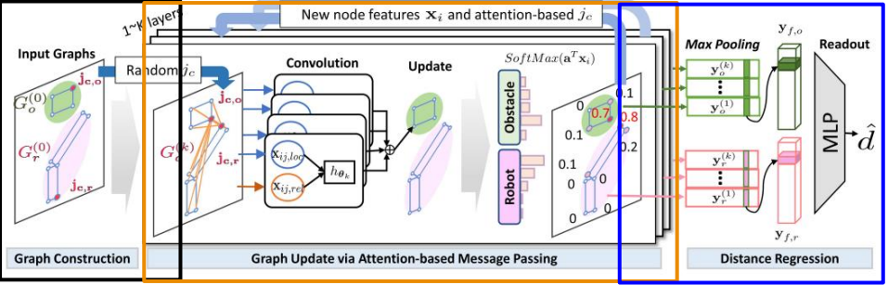
Review
GraphDistNet
Encoding structural information between two geometries by using edge feature-based convolutional operations
Predict a batch of collision distances and gradients, improving trajectory optimization robust to unseen environments
Notes:
Last time, Yeeun introduced GraphDistNet. The process included encoding structural information between two geometries by using edge feature-based convolutional operations. It could predict a batch of collisions and gradients, improving trajectory optimization that is robust to unseen environments.

Slide 3
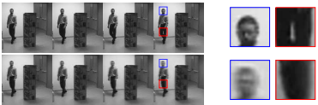

BACKGROUND
Action Prediction
Chaochao Lu, Michael Hirsch, and Bernhard Scholkopf. Flexible spatio-temporal networks for video prediction. In CVPR, pages 6523–6531, 2017.
Notes:
The above paper performs action predictions by generating future frames. It uses customized objective function comprising decoding, encoding, and adversarial losses to mitigate the problem of blurry predictions and retain high frequency information even for relatively distant future predictions.
(Uses FSTN to extrapolate video sequence)

Slide 4
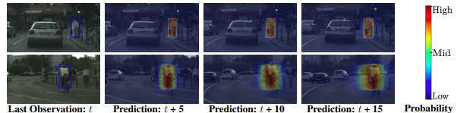
Background
Behavior and Trajectory Estimation
Apratim Bhattacharyya, Mario Fritz, and Bernt Schiele. Long-term on-board prediction of people in traffic scenes under uncertainty. In CVPR, pages 4194–4202, 2018.
Notes:
The above paper proposes a new model that jointly predicts ego motion and people trajectories over such large time horizons. It pays particular attention to modeling the uncertainty of estimates arising from the non-deterministic nature of natural traffic scenes.
(Uses novel two-stream Bayesian LSTM encoder-decoder approach)

Slide 5
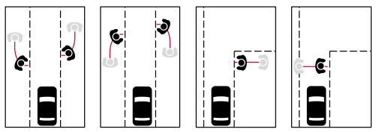
Background
Intention Estimation
Friederike Schneemann and Patrick Heinemann. Context based detection of pedestrian crossing intention for autonomous driving in urban environments. In IROS, pages 2243–2248, 2016.
Notes:
In driver’s perspective, figuring out the pedestrians’ intentions is crucial in driving. The above paper presents context-based feature descriptor in combination with a SVM classifier for selfdriving vehicles to identify pedestrians, whose intended actions are relevant for the own behavior planning, at an early stage.

Slide 6
Contribution
A large-scale pedestrian intention estimation (PIE) dataset which includes hours of video footage of pedestrians at various types of crosswalks collected using a calibrated on-board camera with ego-vehicle information
A human baseline for pedestrian intention estimation established by conducting in-lab and largescale online experiments involving human subjects of different ages and driving backgrounds
Algorithm that combines past trajectory information and local visual context for predicting pedestrians’ intention of crossing
Trajectory prediction algorithm that achieves state-of-the-art performance on PIE and JAAD datasets
Notes:
A large-scale pedestrian intention estimation (PIE) dataset which includes hours of video footage of pedestrians at various types of crosswalks collected using a calibrated on-board camera with ego-vehicle information
A human baseline for pedestrian intention estimation established by conducting in-lab and largescale online experiments involving human subjects of different ages and driving backgrounds
Algorithm that combines past trajectory information and local visual context for predicting pedestrians’ intention of crossing
Trajectory prediction algorithm that achieves state-of-the-art performance on PIE and JAAD datasets

Slide 7
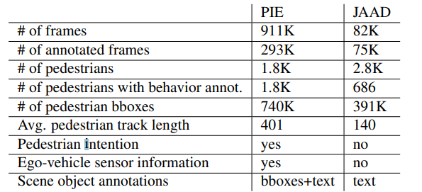
Dataset
Comparison with recently proposed dataset containing pedestrian samples with temporal correspondence

Slide 8
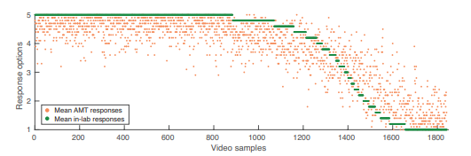
Human Experiment (Intention)
 | Lab Participant | AMT Participant
ICC² | 0.97 | 0.93
Pearson Correlation Coefficient | 0.90

Slide 9
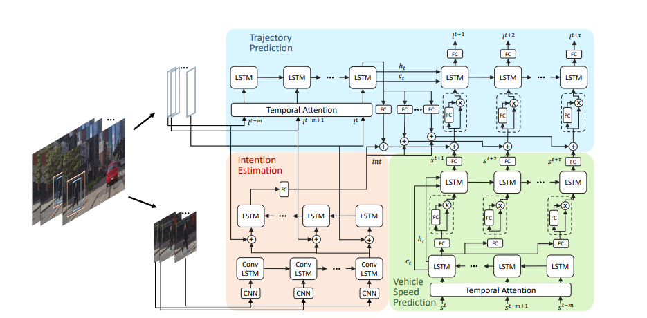
Intention Estimation and Trajectory Prediction Framework
RNN encoder-decoder architecture
l = bounding box around the pedestrian
c = context around pedestrian
s = predicted future speed of the ego-vehicle

Slide 10
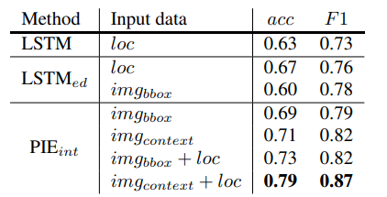
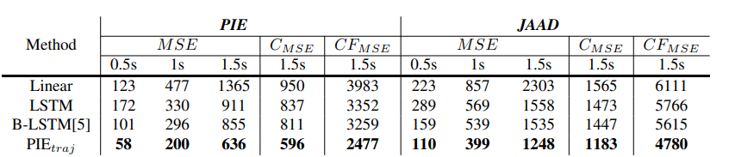
Evaluation
Pedestrian Intention Estimation Result
Location Prediction Errors

Slide 11
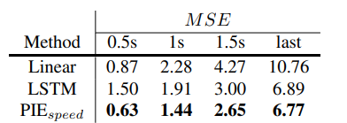
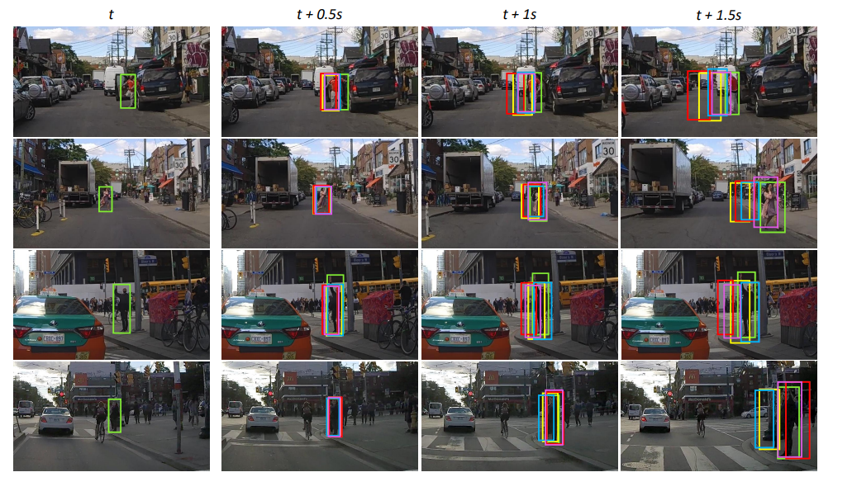
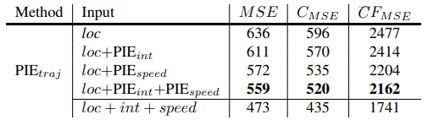
Evaluation
Speed Prediction Errors
Location Prediction Errors

Slide 12
Conclusion
Novel large-scale dataset for studying pedestrian crossing intention and behavior with annotations
Large-scale human experiment for acquiring reference data for crossing intention
Baseline model for pedestrian intention estimation
Trajectory prediction for an on-board camera
Notes:
Mobile Mapping System (MMS) and the other by Cartographer

Slide 13
Quiz
1. What architecture is the proposed model for intention estimation and trajectory prediction based on?
2. Does PIE dataset include ego-vehicle sensor information? (T/F)

