Slide 1
3D City Modeling from Multi Sensor
2020.11.17
20205309
Chungsu Jang
Notes:
1
Hello, all Today, I’ll talk about my project outline .
My project topic is about 3d city modeling from multi sensor
sensor is mainly satellate and airbon imagery
Here, I’ll propose compact method for urban modeling
Related to this class It considered the next best viewpoint
but the path (or sequence of viewpoints) for it to take

Slide 2
Contents
Motivation
Related Work
Project Outline
Schedule
Notes:
Follwing sequence, I’ll introduce project outline

Slide 3
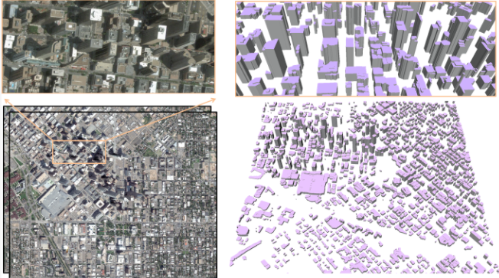
Motivation
The Big challenges in urban reconstruction
Ref: https://raweb.inria.fr/rapportsactivite/RA2016/titane/uid54.html
Notes:
Automatic city modeling from satellite imagery is one of the biggest challenges in urban reconstruction.
Existing methods produce at best rough and dense Digital Surface Models. Inspired by recent works on
semantic 3D reconstruction and region-based stereovision, I want to propose a method for producing compact,
semantic-aware and geometrically accurate 3D city models from stereo pair of satellite images
I want to get geometry and semantics bringing robustness to occlusions and to low image quality.

Slide 4
Contents
Motivation
Related Work
Project Outline
Schedule
Notes:
Next content is related work.

Slide 5
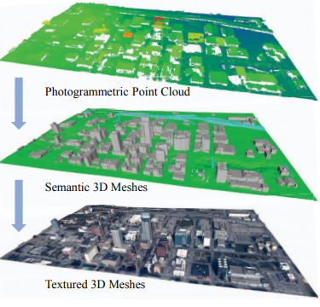
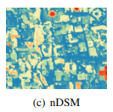
Related Work
Urban 3D reconstruction
  Urban Semantic 3D reconstruction from Multiveiw Satellite Imagery, CVPR 2019
Notes:
Urban 3D Reconstruction is widely studied.
Urban Semantic 3D reconstruction from Multiveiw Satellite Imagery is a representative sample of the latest papers.
It used point cloud data extracted from sattellite imagery as input data,
And it generate textured 3d mesh,
In the intermediate product DSM(digital surface model), It classify many buildings using deep learning architecture, DenseUNet
This paper's content is similar to my concept.

Slide 6

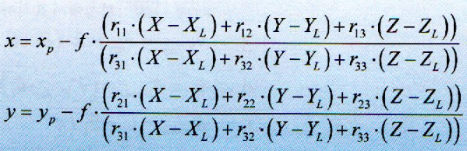
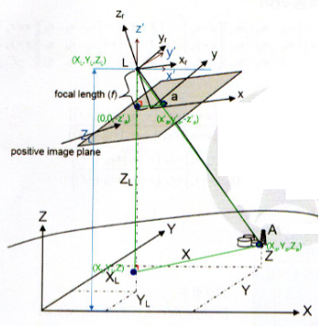
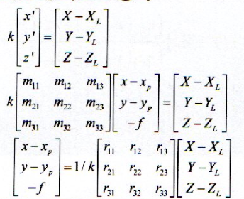


Related Work
Geo referencing : mapping image pixels to global coordinates, photometry
R : RPC(The rational polynomial coefficient)
GtoI()
ItoG()
Ref: Introduction to Photogrammetry and Remote sensing, 1st Edition
Notes:
Next related work is geo referencing method.
Using the proportional relationship between the image plane and the surface,
Image coordinate system and coordinates in spatial space can be converted to each other.
R is rational polynominal coefficient.
It Usually provided depending on the sensor.
We can simply use the GtoI, ItoG, two functions.
In my work, to generate altimeter record of buildngs, I use ItoG function

Slide 7
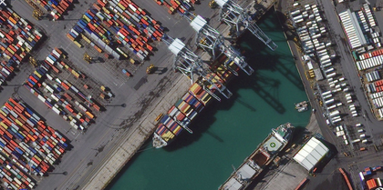
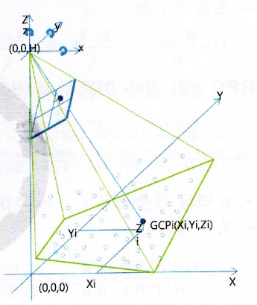
Related Work
Geo referencing
RPC(The rational polynomial coefficient)
Push broom - EO
Ref: Introduction to Photogrammetry and Remote sensing, 1st Edition
Notes:
R계수를 모르기 때문에 일종의 피팅을 합니다.

Slide 8
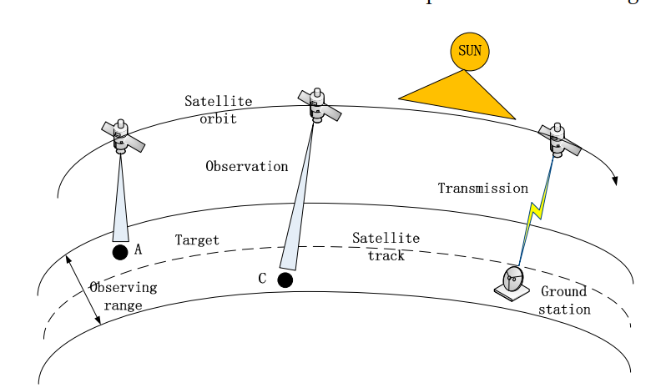
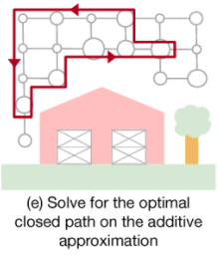
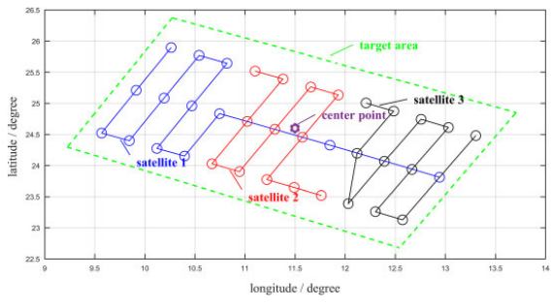
Related Work
Minimizing path length(=minimal images), maximizing quality of stereo image
  A Satellite Task Planning Algorithm Based on a Symmetric Recurrent Neural Network, Journal of Symmetry 2019
  Submodular Trajectory Optimization for Aerial 3D scanning, ICCV 2017
Notes:
Next related work is path planning of image sensor for 3d scanning
The mission plan of a satellite is the concept of visiting an object to be recorded on a specified track.
It's like visiting a subway station.
When there are multiple satellites, along the track, research is being conducted by photographing areas that do not overlap each other.
The aerial sensor is solving the problem of visiting the smallest point where the highest quality 3D image can be obtained while acquiring as few images as possible.
Most works related to optimization problem.
In reality, it is impossible to control actual aerial and satellite assets, so in this project, I want to proceed to the extent that it recommends the next shooting location based on the acquired video.

Slide 9
Contents
Motivation
Related Work
Project Outline
Schedule
Notes:
Next is my project outline.

Slide 10
Project Outline
System Flow
Satellite/Aerial Resources
SM (RFM/FCM)
Polygonal Partitioning to Cell
Labelling Cell (Façade, Root, Ground)
Triangular facets in 3D model
Recommend Next Sensor, Next Path
Notes:
My system get

Slide 11
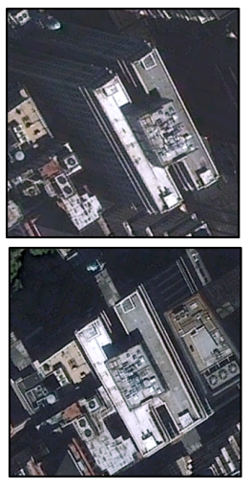
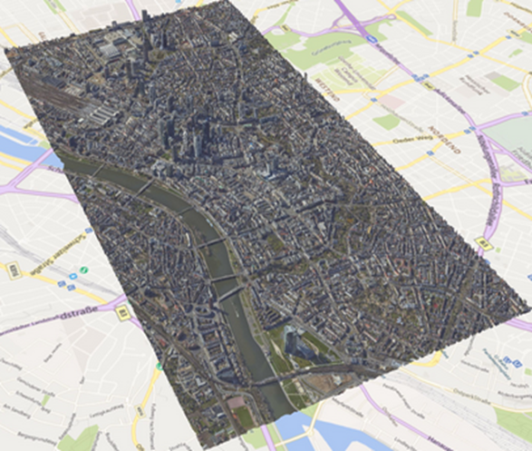
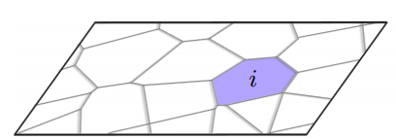
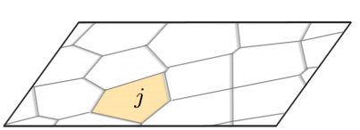
Project Outline
Polygonal Partioning
X, Y, D
x, y
ItoG
X’, Y’, D’
x’, y’
ItoG
Notes:
다른 면은 occlusion이 일어납니다. One side 만 보입니다.
Best View Selection
Image2Ground
Polygonal Partitioning to Cell
Labelling Cell
Generation Triangual Facet

Slide 12
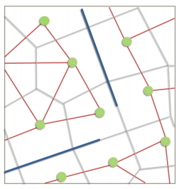
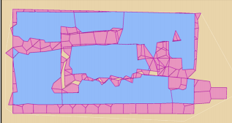
Project Outline
Cell Labelling
Image A Cell
Gap-filling
Image B Cell
Notes:
Occlusion 일어난 부분을 Gapfilling 해주는 개념입니다.

Slide 13
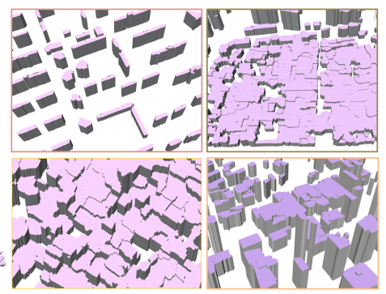
Project Outline
Triangular facet
Notes:
예상되는 결과압니다.

Slide 14
Project Outline
Recommend Next Sensor, Best View
  Based on collected images
WorldView-Sat
Geoeye-Sat
Notes:
개념만 적용하고자 합니다.

Slide 15
Contents
Motivation
Related Work
Project Outline
Schedule

Slide 16
Schedule
Schedule of Work
Satellite(WV, GEOEYE)/Aerial image
~11.20
Polygonal Partitioning to Cell
~11/27
Labelling Cell
z
~12/4
Generation Triangural Facet
~12/8
Recommend Next Sensor, Next Path
~12/8
Presentation
~12/10

