Slide 1

Appearance Models
Sung-Eui Yoon
(윤성의)
Course URL:
http://sglab.kaist.ac.kr/~sungeui
Notes:
1

Slide 2
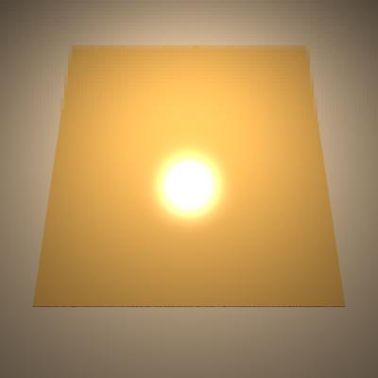
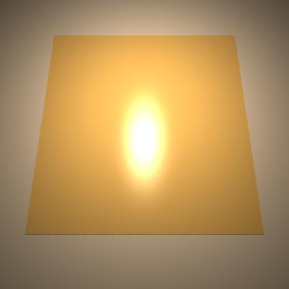
Ward BRDF Model
Another empirical model
Supports anisotropy, and works well for metals
Roughness parameters:
0.1, 0.1 0.1, 0.2
Ack. of Premoze

Slide 3
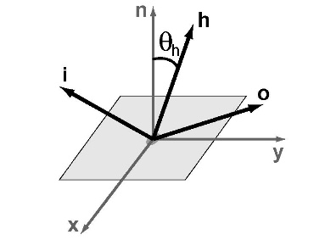
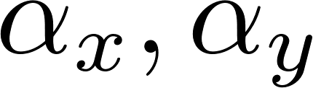
Ward BRDF Model
2D coordinate frames
Diffuse terms
Anisotropic terms:
( ) controls X and Y width of highlights

Slide 4
Microfacet models for refraction through rough surfaces
Bruce Walter Steve Marschner Hongsong Li Ken Torrance
Cornell University Program of Computer Graphics
Modified from original slides

Slide 5
Microfacet scattering models
Assumptions
rough dielectric surface
single scattering
microsurface
macrosurface
air
Dielectric, e.g., ceramic and plastic

Slide 6
Microfacet reﬂection models
Incident irradiance Ei illuminates macrosurface area dA from direction i.
E_{i}
i
dA

Slide 7
Microfacet reﬂection models
Incident irradiance Ei illuminates macrosurface area dA from direction i.
E_{i}
dω_{o}
i
L_{r}
Reﬂected radiance Lr measured at direction o in solid angle dωo.
L
Bidirectional R
eﬂectance D
istribution
Function:
f (i, o) =
r
r
E_{i}

Slide 8
Microfacet reﬂection models
Incident irradiance Ei illuminates macrosurface area dA from direction i.
E_{i}
i
Reﬂected radiance Lr measured at direction o in solid angle dωo.
L_{t}
dω_{o}
L
Bidirectional R
eﬂectance D
istribution
Function:
f (i, o) =
r
r
E_{i}
L
Bidirectional T
ransmittance D
istribution F
unction:
f (i, o) =
t
t
E_{i}

Slide 9
Reﬂection to transmission
Traditional microfacet reﬂection model:
F (i, m) D(m) G(i, o, m) 4|i·n| |o·n|
f_{r}(i, o) =
Notes:
오른쪽 아래에 있는 화살은 아래로 향하고 있어서, transmission 을나타내고 있지만, 지금부터 대부분의 설명은 reflection을 나타냄.

Slide 10
Reﬂection to transmission
Traditional microfacet reﬂection model:
optical geometric
F (i, m) D(m) G(i, o, m) 4|i·n| |o·n|
f_{r}(i, o) =
We generalize the geometric analysis dealing with the surface area where scattering occurs.

Slide 11
“half-vector” function
h(i, o)
normal distribution
D(m)
shadowing–masking
G(i, o, m)
i

Slide 12
“half-vector” function
h(i, o)
normal distribution
D(m)
shadowing–masking
G(i, o, m)
h gives the one microsurface normal m
that will scatter light from i to o.
i

Slide 13
“half-vector” function
h(i, o)
normal distribution
D(m)
shadowing–masking
G(i, o, m)
h gives the one microsurface normal m
that will scatter light from i to o.
selects m
= h(i,o)
i

Slide 14
“half-vector” function
h(i, o)
normal distribution
D(m)
shadowing–masking
G(i, o, m)
dω_{m}
= h(i,o)
h gives the one microsurface normal m
that will scatter light from i to o.
selects m
determines size of dωm
i
dω_{o}

Slide 15
“half-vector” function
h(i, o)
normal distribution
D(m)
shadowing–masking
G(i, o, m)
h gives the one microsurface normal m
that will scatter light from i to o.
dω_{m}
i

Slide 16
“half-vector” function
h(i, o)
normal distribution
D(m)
shadowing–masking
G(i, o, m)
h gives the one microsurface normal m
that will scatter light from i to o.
D measures density of microsurface area with respect to microsurface normal m. defined over solid angles
dω_{m}
i

Slide 17
“half-vector” function
h(i, o)
normal distribution
D(m)
shadowing–masking
G(i, o, m)
h gives the one microsurface normal m
that will scatter light from i to o.
D measures density of microsurface area with respect to microsurface normal m. defined over solid angles
dω_{m}
i
dA^{m}
dA
dA^{m} =
D(m) dω_{m} dA

Slide 18
“half-vector” function
h(i, o)
normal distribution
D(m)
shadowing–masking
G(i, o, m)
h gives the one microsurface normal m
that will scatter light from i to o.
D measures density of microsurface area with respect to microsurface normal m.
G measures the fraction of points with microsurface normal m that are visible.
dω_{m}
i
dA^{m}
dA
dA^{m} =
D(m) dω_{m} dA

Slide 19
“half-vector” function
h(i, o)
normal distribution
D(m)
shadowing–masking
G(i, o, m)
h gives the one microsurface normal m
that will scatter light from i to o.
D measures density of microsurface area with respect to microsurface normal m.
G measures the fraction of points with microsurface normal m that are visible.
dω_{m}
i
dA^{m}
dA
dA^{m} = G(i, o, m) D(m) dω_{m} dA

Slide 20
“half-vector” function
h(i, o)
normal distribution
D(m)
shadowing–masking
G(i, o, m)
For reﬂection or transmission:
|i · m|
|i · n| |o · n|
dA^{m}
f_{s}(i, o) =
ρ(i, o)
dA dω_{o}
dA^{m} = G(i, o, m) D(m) dω_{m} dA

Slide 21
“half-vector” function
h(i, o)
normal distribution
D(m)
shadowing–masking
G(i, o, m)
For reﬂection or transmission:
|i · m|
dω
f (i, o) =
ρ(i, o) D(m)
G(i, o, m)
m
s
|i · n| |o · n|
dω_{o}
dA^{m} = G(i, o, m) D(m) dω_{m} dA

Slide 22
“half-vector” function
h(i, o)
normal distribution
D(m)
shadowing–masking
G(i, o, m)
For reﬂection or transmission:
easy to generalize
|i · m|
dω
f (i, o) =
ρ(i, o) D(m) G(i, o, m)
m
s
|i · n| |o · n|
dω_{o}
dA^{m} = G(i, o, m) D(m) dω_{m} dA

Slide 23
“half-vector” function
h(i, o)
normal distribution
D(m)
shadowing–masking
G(i, o, m)
For reﬂection or transmission:
easy to generalize
|i · m|
dω
f (i, o) =
ρ(i, o) D(m) G(i, o, m)
m
s
|i · n| |o · n|
dω_{o}
key contribution
dA^{m} = G(i, o, m) D(m) dω_{m} dA

Slide 24
Construction of half-vector solid angle
reﬂection
h_{r} = normalize(i + o)
dω_{o}
refraction
h_{t} = −normalize(i + no)
dω_{m}
dω_{o}
h_{r}
i
₌ |o · h_{r}|
i + o ²
dω
dω
m
o

Slide 25
Construction of half-vector solid angle
reﬂection
h_{r} = normalize(i + o)
dω_{o}
dω_{m}
dω_{o}
_{i} h_{r}
o · h_{r}|
dω_{m} = | dω_{o}
i + o ²
refraction
h_{t} = −normalize(i + no)
dω_{m}
i
h_{t}
n
n²dω_{o}
dω_{o}
|o · h_{t}|
i + no ²
dω =
n²dω
m
o

Slide 26
Result: scattering functions
reﬂection
F (i, h_{r}) D(h_{r}) G(i, o, h_{r}) 4|i·n| |o·n|
f_{r}(i, o) =
transmission
|i·h_{t}| |o·h_{t}| n²(1 − F (i, h_{t})) D(h_{t}) G(i, o, h_{t})
|i·n| |o·n| li + nol²
f_{t}(i, o) =

Slide 27
Normal distributions
Choice of distribution is determined by surface
Phong describes same surfaces as Beckman
new GGX distribution ﬁts some surfaces better
analytical Smith shadowing–masking
8
Phong
–40
–20
20
40
D(θ_{m})

Slide 28
Normal distributions
Choice of distribution is determined by surface
Phong describes same surfaces as Beckman
new GGX distribution ﬁts some surfaces better
analytical Smith shadowing–masking
8
Phong
Beckman
–40
–20
20
40
D(θ_{m})

Slide 29
Normal distributions
Choice of distribution is determined by surface
Phong describes same surfaces as Beckman
new GGX distribution ﬁts some surfaces better
analytical Smith shadowing–masking
8
Phong Beckman GGX (new)
–40
–20
20
40
D(θ_{m})

Slide 30
Normal distributions
Choice of distribution is determined by surface
Phong describes same surfaces as Beckman
new GGX distribution ﬁts some surfaces better
analytical Smith shadowing–masking
8
Phong Beckman GGX (new)
1
–40
–20
20
40
–90
90
D(θ_{m})
G₁(θ_{i,o})

Slide 31
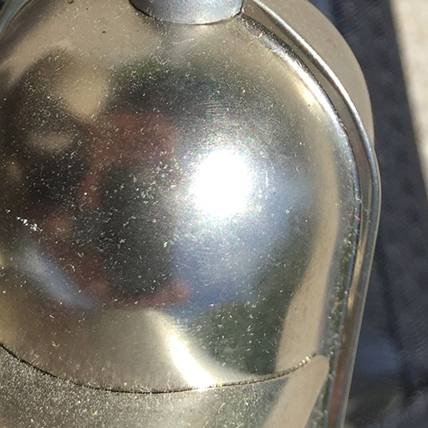
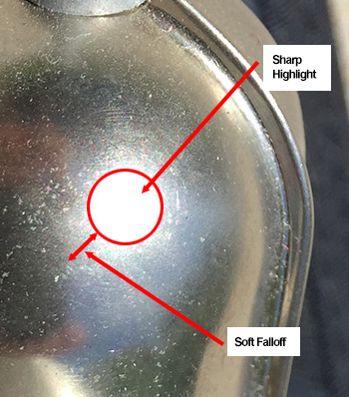
Effects of Distribution Function
Sharp highlight with soft falloff
A captured highlight of a chrome, GGX, and Beckmann distributions

Slide 32
Measuring transmission

Slide 33
Measuring transmission

Slide 34
Measuring transmission

Slide 35
Measuring transmission

Slide 36
Measuring transmission
Notes:
재반사가 일어나는 문제가 있어서, 이것을 줄이는 lense를 뒤에 부착

Slide 37
Measuring transmission

Slide 38
Measuring transmission

Slide 39
Measuring transmission

Slide 40
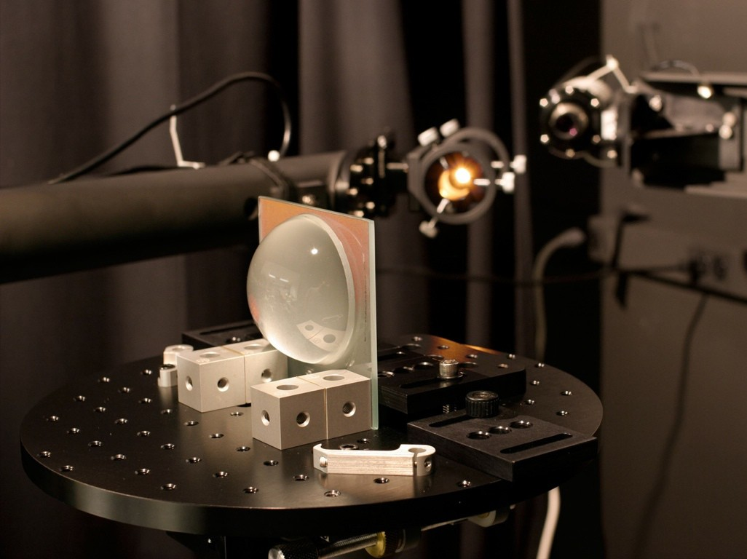
Measurement setup

Slide 41
Validation: ground glass
0°
GGX ﬁt
0°
Beckman ﬁt
5
5
4
4
BSDF
3
3
2
2
1
1
120
150
180
θt
210
240
270
120
150
180
θt
210
240
270
Fit is to normal incidence data only

Slide 42
Validation: ground glass
0°
GGX ﬁt
0°
Beckman ﬁt
5
5
4
4
BSDF
3
3
2
2
1
1
120
150
180
θt
210
240
270
120
150
180
θt
210
240
270
Fit is to normal incidence data only

Slide 43
Validation: ground glass
0°
GGX ﬁt
0°
Beckman ﬁt
5
5
30°
30°
4
4
BSDF
3
3
60°
60°
2
2
80°
1
1
80°
120 | 150 | 180 | 210 | 240 | 270 | 120 | 150 | 180 | 210 | 240 | 270
 |  | θt |  |  |  |  |  | θt
Fit is to normal incidence data only

Slide 44
Validation: “frosted” glass
5
5
GGX ﬁt
Beckman ﬁt
4
4
3
3
BSDF
2
2
1
1
120
150
180
θt
210
240
270
120
150
180
θt
210
240
270
Fit is to normal incidence data only

Slide 45
Validation: acid-etched glass
3.5
3
2.5
2
1.5
1
0.5
GGX ﬁt
3.5
3
2.5
2
1.5
1
0.5
Beckman ﬁt
BSDF
120
150
180
θt
210
240
270
120
150
180
θt
210
240
270
Fit is to normal incidence data only

Slide 46
Validation: antiglare glass
1200
1000
800
GGX ﬁt
1200
1000
800
Beckman ﬁt
BSDF
600
600
400
400
200
200
120
150
180
θt
210
240
270
120
150
180
θt
210
240
270

Slide 47
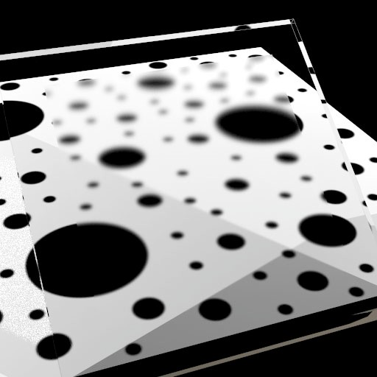
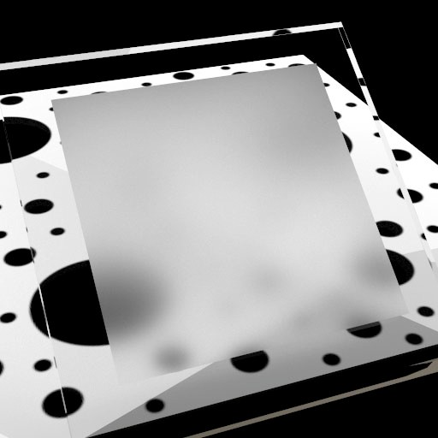
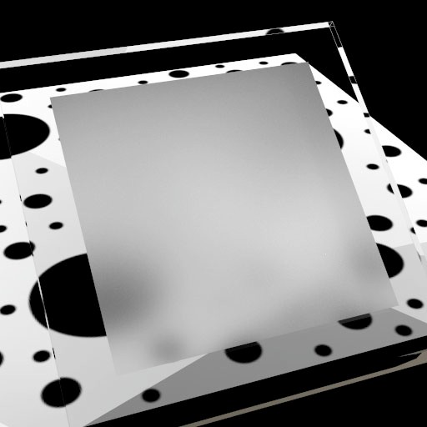
Transmission through rough glass
anti-glare glass Beckman, αb = 0.023
ground glass GGX, αg = 0.394
acid-etched glass GGX, αg = 0.553

Slide 48

Etched globe

