Slide 1
CS580:
Rendering Equation
Sung-Eui Yoon
(윤성의)
Course URL:
http://sglab.kaist.ac.kr/~sungeui/GCG
Notes:
1

Slide 2
Class Objectives
Derive the rendering equation
Transform it to area integration

Slide 3
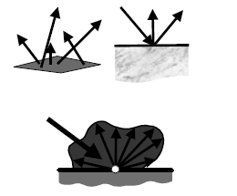
Light and Material Interactions
Physics of light
Radiometry
Material properties
Rendering equation
From kavita’s slides

Slide 4
Light Transport
Goal
Describe steady-state radiance distribution in the scene
Assumptions
Geometric optics
Achieves steady state instantaneously

Slide 5
Rendering Equation
Describes energy transport in the scene
Input
Light sources
Surface geometry
Reflectance characteristics of surfaces
Output
Value of radiances at all surface points in all directions

Slide 6
Rendering Equation
$$L$$
$$L_{e}$$
$$L_{r}$$
$$Ψ$$
$$Θ$$
$$=$$
$$Θ$$
$$+$$
$$Θ$$

Slide 7
Rendering Equation
$$L$$
$$L_{e}$$
$$L_{r}$$
$$Ψ$$
$$Θ$$
$$=$$
$$Θ$$
$$+$$
$$Θ$$

Slide 8
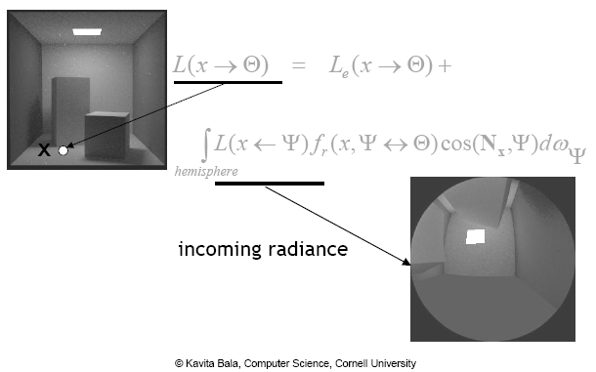
Rendering Equation

Slide 9
Rendering Equation: Area Formulation

Slide 10
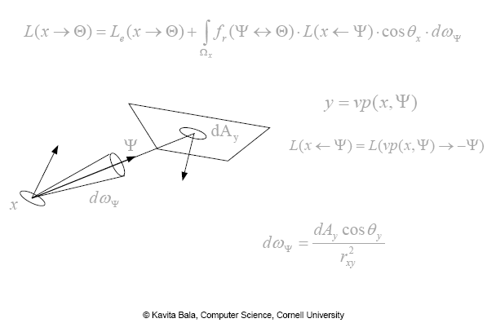
Rendering Equation

Slide 11
Rendering Equation: Visible Surfaces

Slide 12
Rendering Equation: All Surfaces
$$y$$
$$dA$$
$$V$$
$$−Ψ$$
$$Ψ$$
$$x$$

Slide 13
Two Forms of the Rendering Equation
Hemisphere integration
Area integration

Slide 14
Class Objectives were:
Derive the rendering equation
Transform it to area integration

Slide 15
Homework
Go over the next lecture slides before the class
Watch 2 SIGGRAPH videos and submit your summaries every Tue. class
Just one paragraph for each summary
Example:
Title: XXX XXXX XXXX
Abstract: this video is about accelerating the performance of ray tracing. To achieve its goal, they design a new technique for reordering rays, since by doing so, they can improve the ray coherence and thus improve the overall performance.

Slide 16
Any Questions?
Come up with one question on what we have discussed in the class and submit at the end of the class
1 for already answered questions
2 for typical questions
3 for questions with thoughts
Submit questions at least four times before the mid-term exam
Multiple questions for the class is counted as only a single time

Slide 17
Next Time
Monte Carlo ray tracing

Slide 18
Figs.

Slide 19
$$y$$
$$dA$$
$$V$$
$$−Ψ$$
$$Ψ$$
$$x$$

