Slide 1

CS580:
Radiometry
Sung-Eui Yoon
(윤성의)
Course URL:
http://sglab.kaist.ac.kr/~sungeui/GCG
Notes:
1

Slide 2
Class Objectives
Know terms of:
  Hemispherical coordinates and integration
  Various radiometric quantities (e.g., radiance)
  Basic material function, BRDF

Slide 3
Announcements
Final project
  Make a team of two
  Think about which paper you want to implement
  Present a paper related to it
Scope of papers
  Papers since the year of 2008

Slide 4
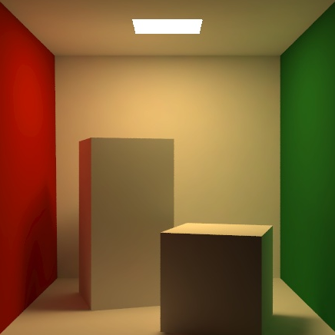
Motivation
Eye
???

Slide 5
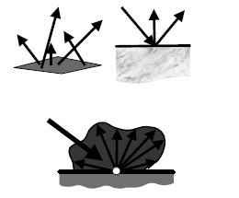
Light and Material Interactions
Physics of light
Radiometry
Material properties
Rendering equation
From kavita’s slides

Slide 6
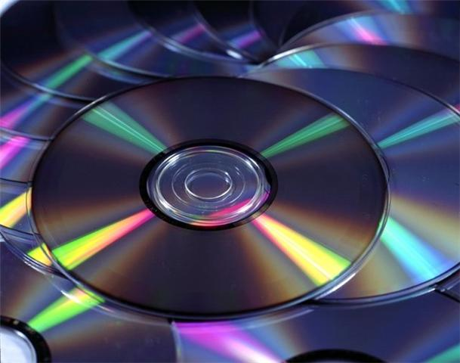
Models of Light
Quantum optics
  Fundamental model of the light
  Explain the dual wave-particle nature of light
Wave model
  Simplified quantum optics
  Explains diffraction, interference, and polarization
Geometric optics
  Most commonly used model in CG
  Size of objects >> wavelength of light
  Light is emitted, reflected, and transmitted

Slide 7
Radiometry and Photometry
Photometry
  Quantify the perception of light energy
Radiometry
  Measurement of light energy: critical component for photo-realistic rendering
  Light energy flows through space, and varies with time, position, and direction
  Radiometric quantities: densities of energy at particular places in time, space, and direction

Slide 8
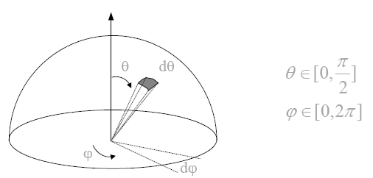
Hemispheres
Hemisphere
  Two-dimensional surfaces
Direction
  Point on (unit) sphere
From kavita’s slides

Slide 9
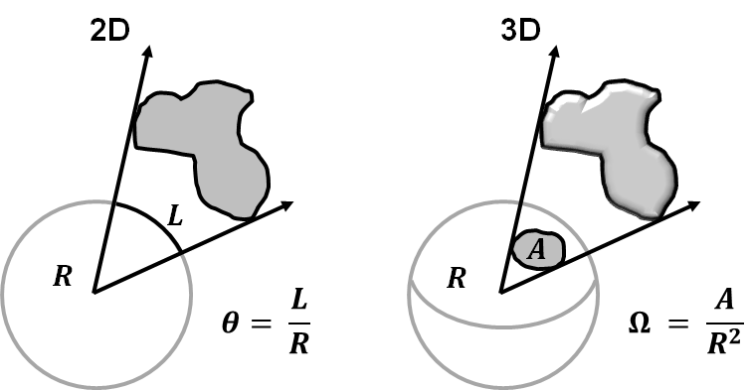
Solid Angles
Full circle
= 2pi radians
Full sphere
= 4pi steradians
Notes:
We are going to do various integration on sphere.
To do that, we need a measure called solid angle.
The solid angle subtended by an object is defined

Slide 10
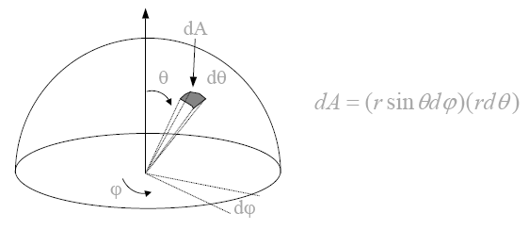
Hemispherical Coordinates
Direction,
  Point on (unit) sphere
From kavita’s slides
Notes:
Consider a smaller 2D circle in the x-y plane (z is upward direction)
r sin is a new radius of that small 2D circle.

Slide 11
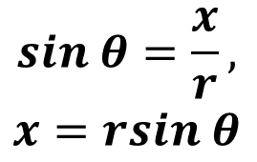


Hemispherical Coordinates
Direction,
  Point on (unit) sphere
From kavita’s slides
Notes:
Consider a smaller 2D circle in the x-y plane (z is upward direction)
r sin is a new radius of that small 2D circle.

Slide 12
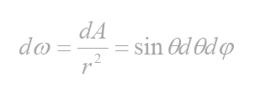
Hemispherical Coordinates
Differential solid angle

Slide 13
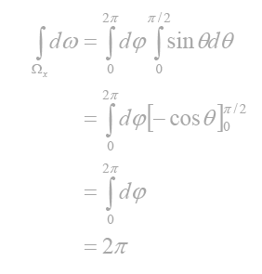
Hemispherical Integration
Area of hemispehre:

Slide 14
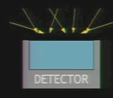
Energy
Symbol: Q
  # of photons in this context
  Unit: Joules
From Steve Marschner’s talk

Slide 15
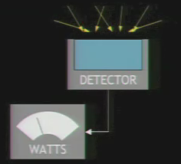
Power (or Flux)
Symbol, P or Φ
  Total amount of energy through a surface per unit time, dQ/dt
  Radiant flux in this context
  Unit: Watts (=Joules / sec.)
  Other quantities are derivatives of P
Example
  A light source emits 50 watts of radiant power
  20 watts of radiant power is incident on a table

Slide 16
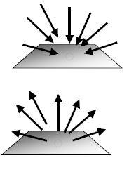
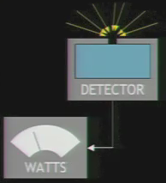
Irradiance
Incident radiant power per unit area (dP/dA)
  Area density of power
Symbol: E, unit: W/ m²
  Area power density existing a surface is called radiance exitance (M) or radiosity (B)
For example
  A light source emitting 100 W of area 0.1 m²
  Its radiant exitance is 1000 W/ m²

Slide 17
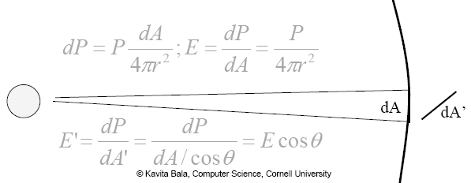
Irradiance Example
Uniform point source illuminates a small surface dA from a distance r
  Power P is uniformly spread over the area of the sphere

Slide 18
Irradiance Example
Uniform point source illuminates a small surface dA from a distance r
  Power P is uniformly spread over the area of the sphere
θ

Slide 19
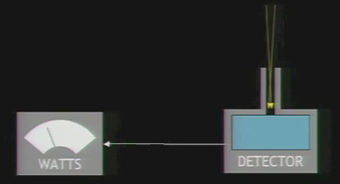
Radiance
Radiant power at x in direction θ
  : 5D function
    Per unit area
    Per unit solid angle
Important quantity for rendering

Slide 20
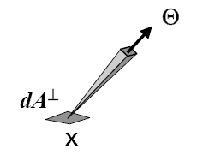
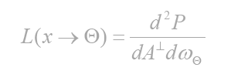

Radiance
Radiant power at x in direction θ
  : 5D function
    Per unit area
    Per unit solid angle
  Units: Watt / (m² sr)
  Irradiance per unit solid angle
  2nd derivative of P
  Most commonly used term

Slide 21
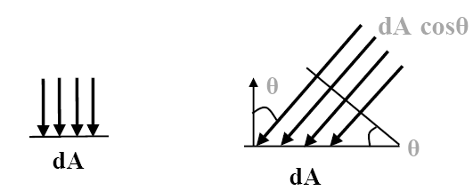
Radiance: Projected Area
Why per unit projected surface area

Slide 22
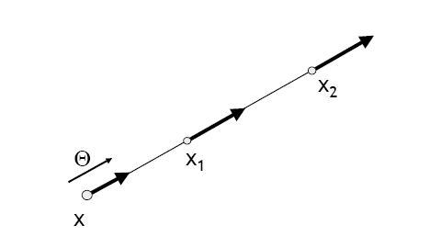
Properties of Radiance
Invariant along a straight line (in vacuum)
From kavita’s slides

Slide 23
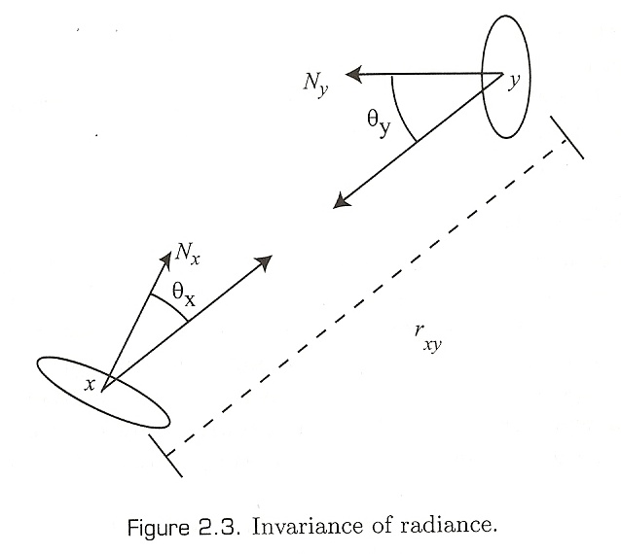
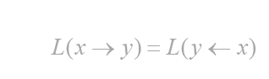
Invariance of Radiance
We can prove it based on the assumption the conservation of energy.
Notes:
L(y <- x) : the amount of energy that we receive at y from x

Slide 24
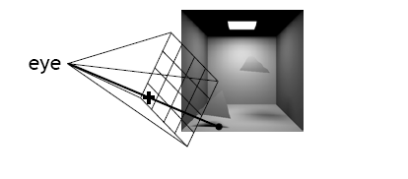
Sensitivity to Radiance
Responses of sensors (camera, human eye) is proportional to radiance
Pixel values in image proportional to radiance received from that direction
From kavita’s slides

Slide 25



Relationships
Radiance is the fundamental quantity
Power:
Radiosity:
Notes:
cos

Slide 26
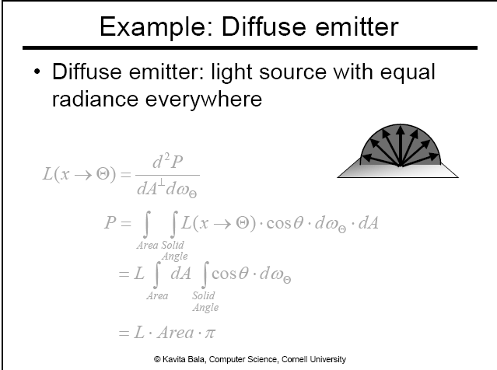

Slide 29
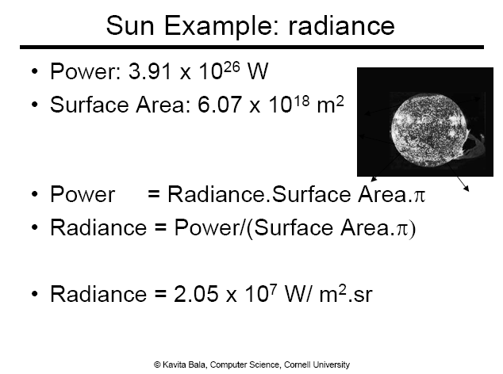

Slide 30
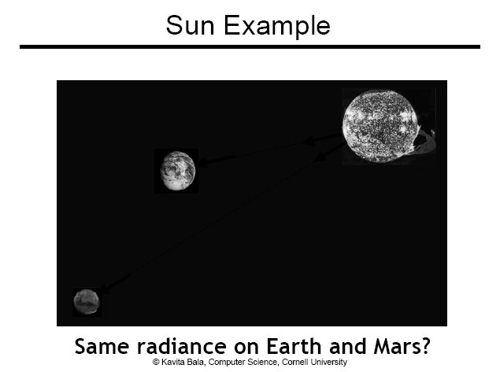
Notes:
Same radiance: sun is equally bright even when you are on Earth and Mars.
But, earth is warmer than Mars, since we get a larger solid angle

Slide 31
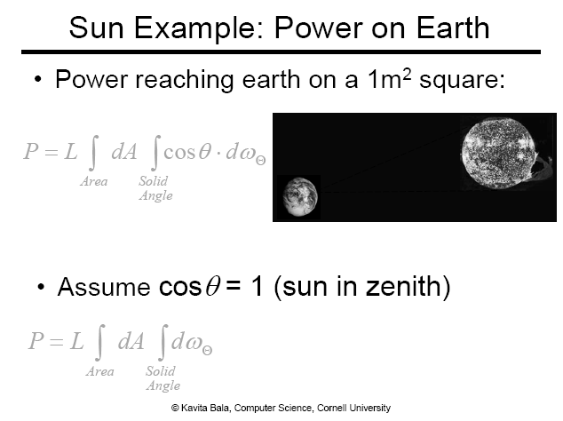

Slide 32
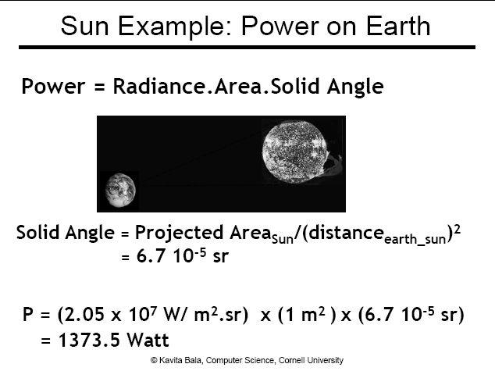

Slide 33
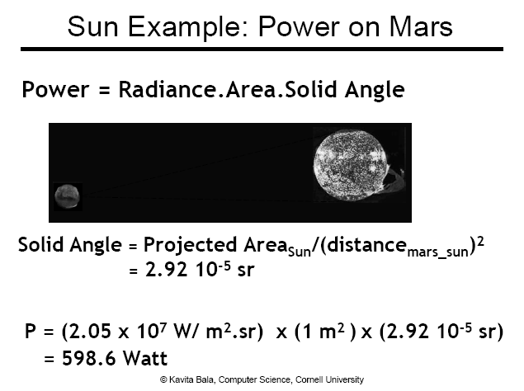

Slide 34
Light and Material Interactions
Physics of light
Radiometry
Material properties
Rendering equation
From kavita’s slides

Slide 35
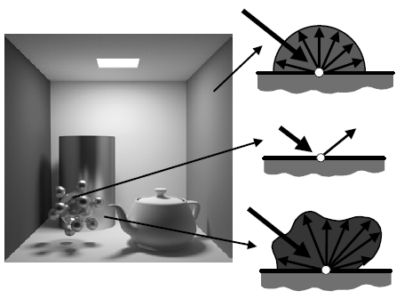
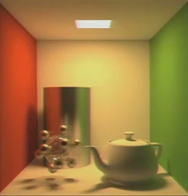
Materials
Ideal diffuse (Lambertian)
Ideal specular
Glossy
From kavita’s slides

Slide 36





Bidirectional Reflectance Distribution Function (BRDF)
Normal
$$Ψ$$
$$Θ$$
$$ψ$$
$$x$$
Notes:
We measure the irradiance (dE) that we receive at the point x.
If we integrate dE over solid angle, then we can get the equation of L cos dw in the denominator.
Why do we use dL?
-> there is a radiance from x to theta, but we use dL to indicate Radiance to be reflected from the incoming angle from psi.
Reflecting radiance is approaching to zero as we have smaller solid angle.
By having solid angle factor in the denominator, BRDF does not approach zero.
This may be related to device (or measuring) issue.

Slide 37
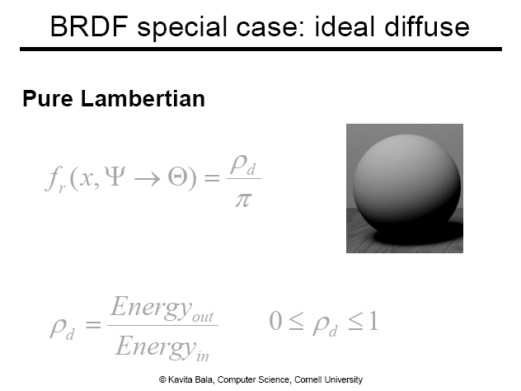
Notes:
Pd -> reflectance

Slide 38
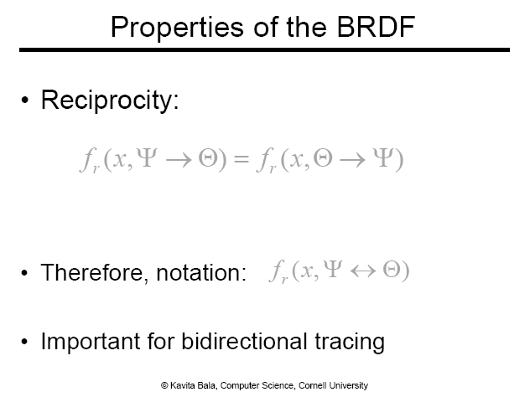

Slide 39
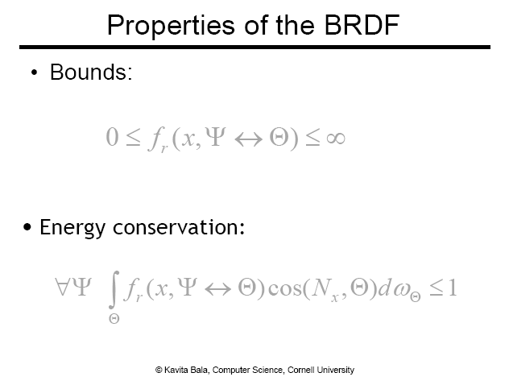
Notes:
BRDF is positive

Slide 40
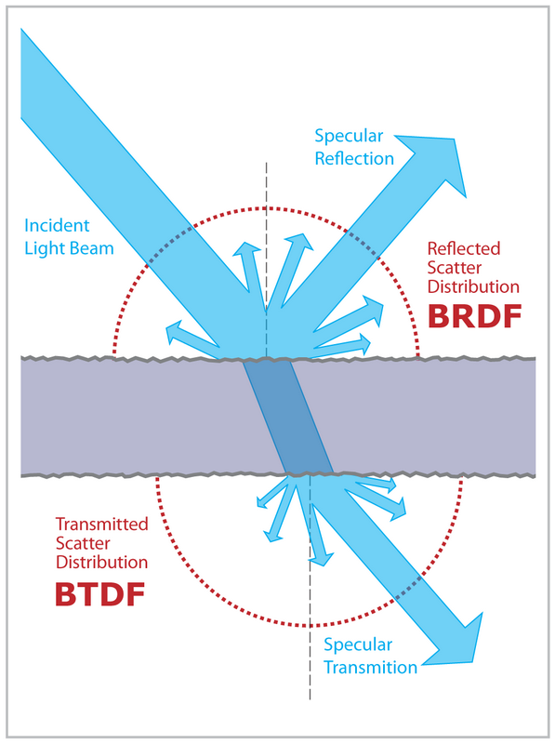
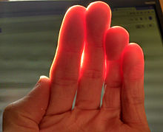
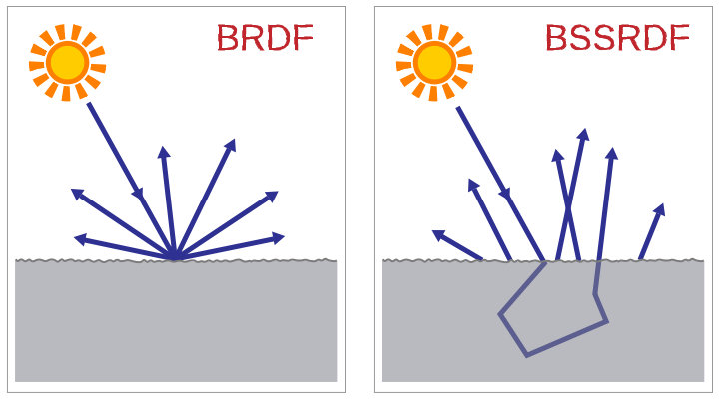
Other Distribution Functions: BxDF
BSDF (S: Scattering)
  The general form combining
  BRDF + BTDF (T: Transmittance)
BSSRDF (SS: Surface Scattering)
  Handle subsurface scattering
wiki

Slide 41
Homework 1
Prove the invaraince

Slide 42
Speaking of Radiometry
“I need to sum all those radiances to compute the irradiance based on hemispherical integration.”
“Do you have a BRDF model for that copper model? If you give me that model, I can support its visual appearance.”

Slide 43
Next Time
Rendering equation

Slide 44
Any Questions?
Come up with one question on what we have discussed in the class and submit at the end of the class
  1 for already answered questions
  2 for typical questions
  3 for questions with thoughts
  4 for questions that surprised me

Slide 45
Figs

Slide 46



Notes:
"여기에 수식을 입력하십시오."

Slide 47




$$Θ$$
$$dA^{⊥}$$
$$dA$$
$$x$$

Slide 48
