Slide 1

CS580:
Radiosity
Sung-Eui Yoon
(윤성의)
Course URL:
http://sglab.kaist.ac.kr/~sungeui/GCG
Notes:
1

Slide 2
Class Objective
Understand radiosity
  Radiosity equation
  Solving the equation

Slide 3
History
Problems with classic ray tracing
  Not realistic
  View-dependent
Radiosity (1984)
  Global illumination in diffuse scenes
Monte Carlo ray tracing (1986)
  Global illumination for any environment

Slide 4
Radiosity
Physically based method for diffuse environments
  Support diffuse interactions, color bleeding, indirect lighting and penumbra
  Account for very high percentage of total energy transfer
  Finite element method

Slide 5
Key Idea #1: Diffuse Only
Radiance independent of direction
  Surface looks the same from any viewpoint
  No specular reflection

Slide 6
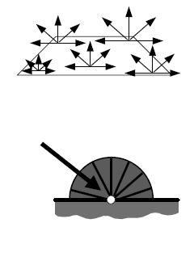
Diffuse Surfaces
Diffuse emitter
  = constant over
Diffuse reflector
  Constant reflectivity
From kavita’s slides

Slide 7
Key Idea #2: Constant Polygons
Radiosity is an approximation
  Due to discretization of scene into patches
  Subdivide scene into small polygons

Slide 8
Constant Radiance Approximation
Radiance is constant over a surface element
  L(x) = constant over x

Slide 9
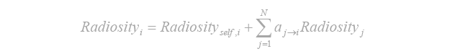
Radiosity Equation
=
+
Self-emitted radiosity
Reflected radiosity
Radiosity

Slide 10
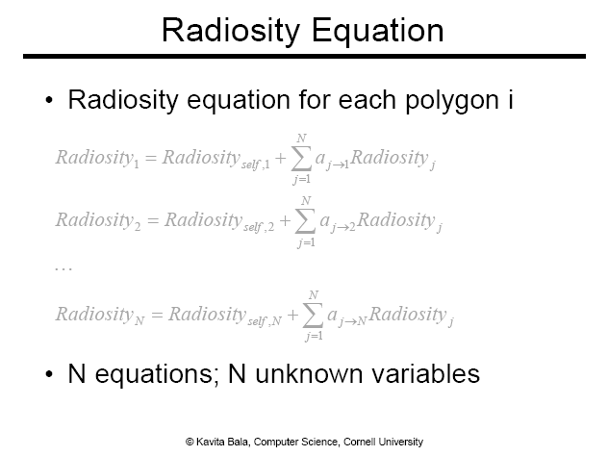

Slide 11
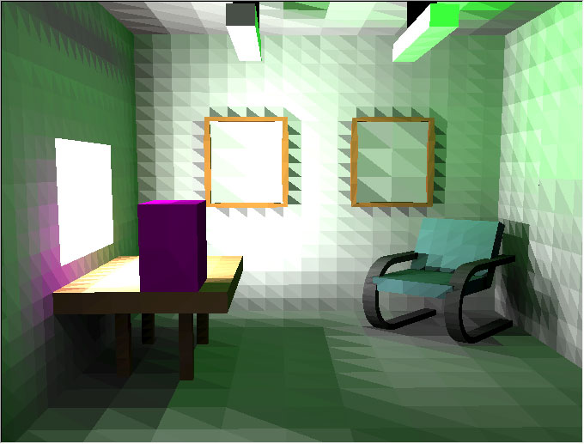
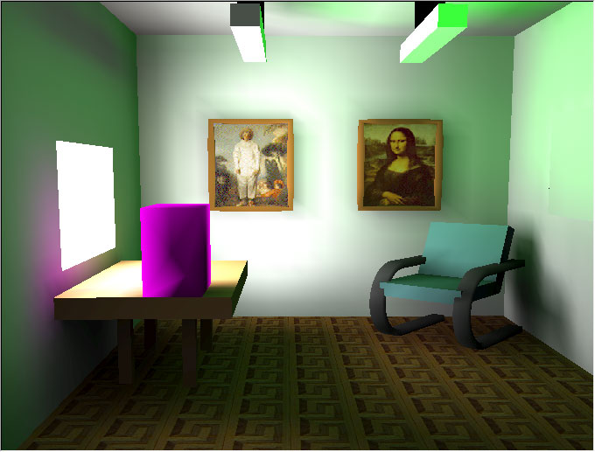
Radiosity Algorithm
Subdivide the scene in small polygons
Compute a constant illumination value for each polygon
Choose a viewpoint and display the visible polygon
  Keep doing this process
From Donald Fong’s slides

Slide 12
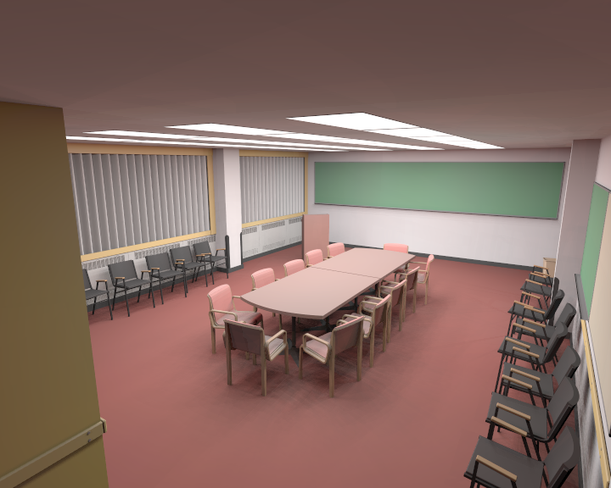
Radiosity Result

Slide 13
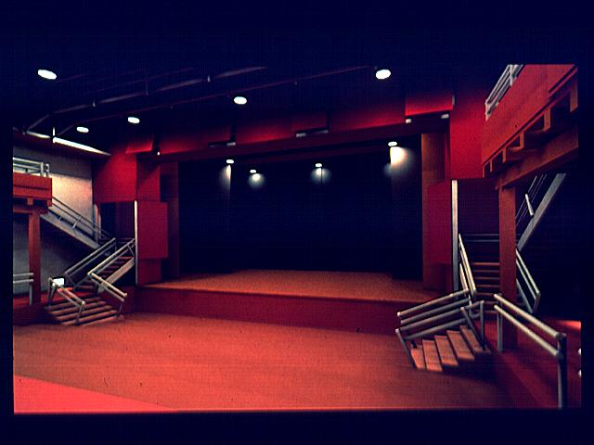
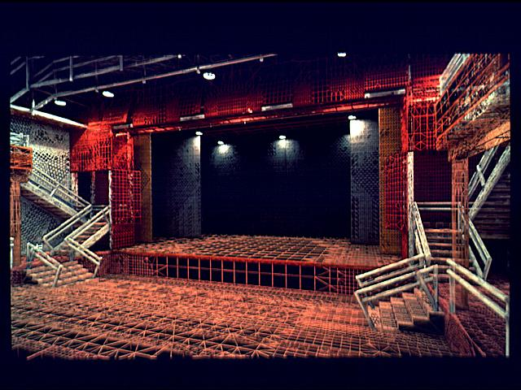
Theatre Scene

Slide 14
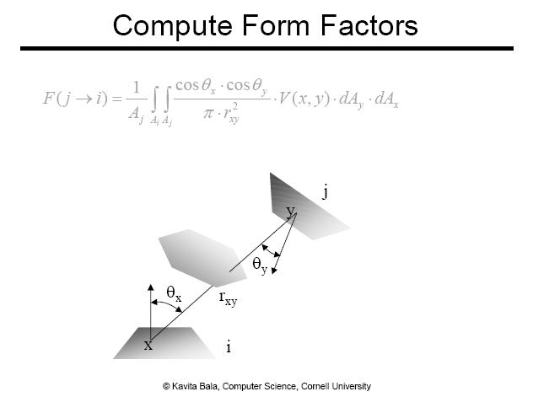

Slide 15
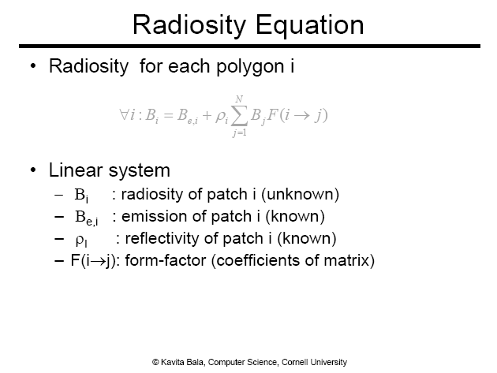

Slide 16
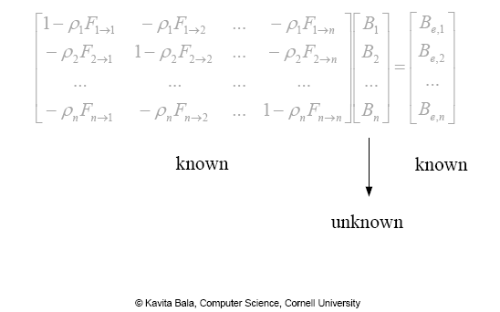
Linear System of Radiosity Equations

Slide 17
How to Solve Linear System
Matrix inversion
  Takes O(n³)
Gather methods
  Jacobi iteration
  Gauss-Seidel
Shooting
  Southwell iteration

Slide 18
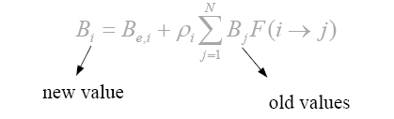
Iterative Approaches
Jacobi iteration
  Start with initial guess for energy distribution (light sources)
  Update radiosity of all patches based on the previous guess
  Repeat until converged
Guass-Seidel iteration
  New values used immediately

Slide 19
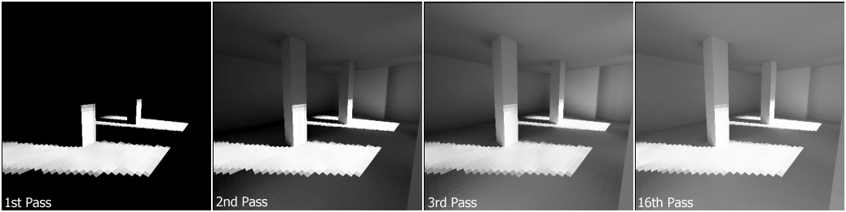
Progress of Update Steps
Update step supports the light bounce

Slide 20
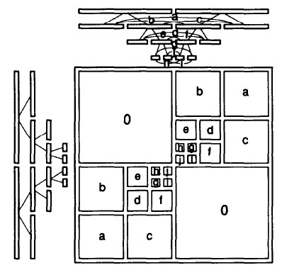
Multi-Resolution Approach
A Rapid Hierarchical Radiosity Algorithm, Hanrahan, et al, SIGGRAPH 1991
Subdivision hierarchy
Refine triangles only if doing so improves the foam factor accuracy above a threshold
Block diagram of the form factor matrix

Slide 21
Hybrid and Multipass Methods
Ray tracing
  Good for specular and refractive indirect illumination
  View-dependent
Radiosity
  Good for diffuse
  Allows interactive rendering
  Does not scale well for massive models
Hybrid methods
  Combine both of them in a way

Slide 22
Instant Radiosity
Use the concept of Radiosity
Map its functions to those of classic rendering pipeline
  Utilize fast GPU
Additional concepts
  Virtual point lights
  Shadow maps
Micro-Rendering for Scalable, Parallel Final Gathering (Video)
  Tobias Ritschel, Thomas Engelhardt, Thorsten Grosch, Hans-Peter Seidel, Jan Kautz, Carsten Dachsbacher
  ACM Trans. Graph. 28(5) (Proc. SIGGRAPH Asia 2009), 2009.

Slide 23
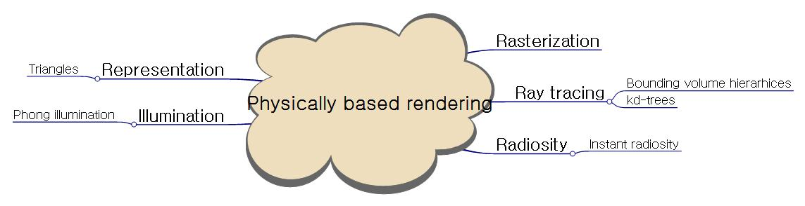
Class Objectives were:
Understand radiosity
  Radiosity equation
  Solving the equation

Slide 24
Next Time
Radiometry

Slide 25
Homework
Go over the next lecture slides before the class
Watch 2 SIGGRAPH videos and submit your summaries every Tue. class
  Just one paragraph for each summary
Example:
Title: XXX XXXX XXXX
Abstract: this video is about accelerating the performance of ray tracing. To achieve its goal, they design a new technique for reordering rays, since by doing so, they can improve the ray coherence and thus improve the overall performance.

Slide 26
Any Questions?
Come up with one question on what we have discussed in the class and submit at the end of the class
  1 for already answered questions
  2 for typical questions
  3 for questions with thoughts
  4 for questions that surprised me

Slide 27
Figs. used in the Book

Slide 29
=
+
Self-emitted radiosity
Reflected radiosity
Radiosity

