Slide 1

CS380: Computer Graphics
Modeling Transformations
Sung-Eui Yoon
(윤성의)
Course URL:
http://sglab.kaist.ac.kr/~sungeui/CG/
Notes:
1

Slide 2
Class Objectives (Ch. 3.5)
Know the classic data processing steps, rendering pipeline, for rendering primitives
Understand 3D translations and rotations

Slide 3
Outline
Where are we going?
  Sneak peek at the rendering pipeline
Vector algebra
Modeling transformation
Viewing transformation
Projections

Slide 4
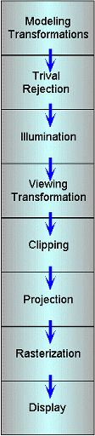
The Classic Rendering Pipeline
Object primitives defined by vertices fed in at the top
Pixels come out in the display at the bottom
Commonly have multiple primitives in various stages of rendering

Slide 5
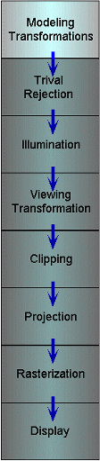
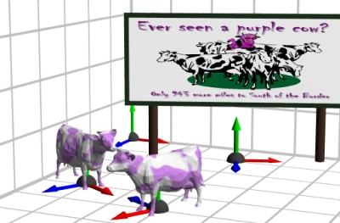
Modeling Transforms
Start with 3D models defined in modeling spaces with their own modeling frames:
Modeling transformations orient models within a common coordinate frame called world space,
  All objects, light sources, and the camera live in world space
Trivial rejection
attempts to
eliminate
objects that
cannot possibly
be seen
  An optimization

Slide 6
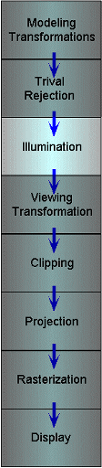
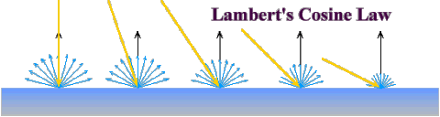
Illumination
Illuminate potentially visible objects
Final rendered color is determined by object’s orientation, its material properties, and the light sources in the scene

Slide 7
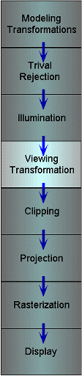
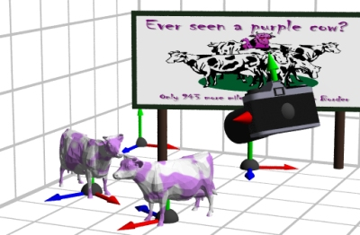
Viewing Transformations
Maps points from world space to eye space:
  Viewing position is transformed to the origin
  Viewing direction is oriented along some axis

Slide 8
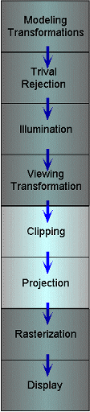
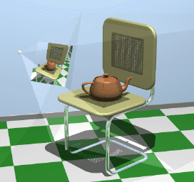
Clipping and Projection
We specify a volume called a viewing frustum
Map the view frustum to the unit cube
Clip objects against the view volume, thereby eliminating geometry not visible in the image
Project objects into two-dimensions
Transform from
eye space to
normalized device
coordinates

Slide 9
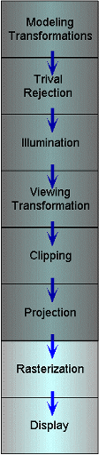
Rasterization and Display
Transform normalized device coordinates to screen space
Rasterization converts objects pixels
- Almost every step in the rendering pipeline involves a change of coordinate systems!
- Transformations are central to understanding 3D computer graphics

Slide 10
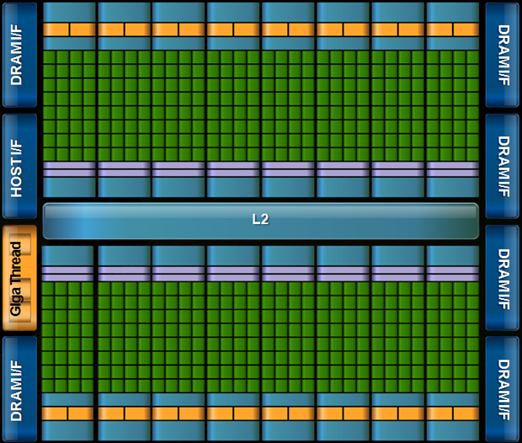
But, this is a architectural overview of a recent GPU (Fermi)
Unified architecture
Highly parallel
Support CUDA (general language)
Wide memory bandwidth

Slide 11
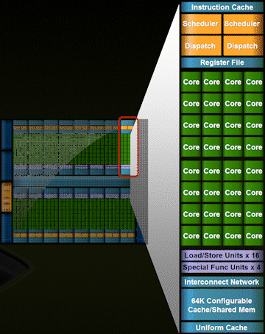
But, this is a architectural overview of a recent GPU

Slide 12
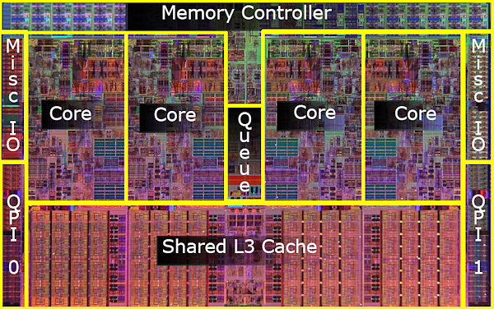
Recent CPU Chips (Intel’s Core i7 processors)

Slide 13
Vector Algebra
We already saw vector addition and multiplications by a scalar
Will study three kinds of vector multiplications
  Dot product (⋅) - returns a scalar
  Cross product (×) - returns a vector
  Tensor product (⊗) - returns a matrix

Slide 14
Dot Product (⋅)
Returns a scalar s
Geometric interpretations s:
  Length of projected onto and or vice versa
  Distance of from the origin in the direction of

Slide 15
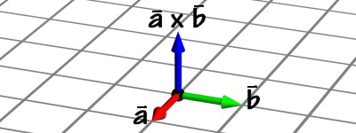
Cross Product (×)
Return a vector that is perpendicular to both and , oriented according to the right-hand rule
The matrix is called the skew-symmetric matrix of

Slide 16
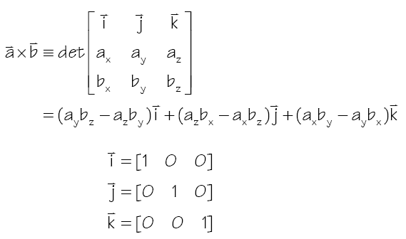
Cross Product (×)
A mnemonic device for remembering the cross-product

Slide 17
Modeling Transformations
Vast majority of transformations are modeling transforms
Generally fall into one of two classes
  Transforms that move parts within the model
  Transforms that relate a local model’s frame to the scene’s world frame
Usually, Euclidean transforms, 3D rigid-body transforms, are needed

Slide 18
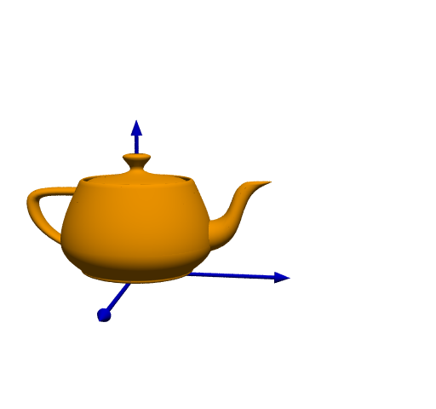
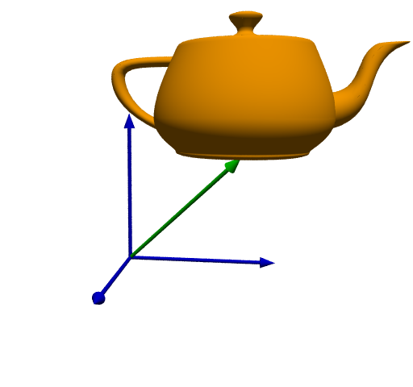
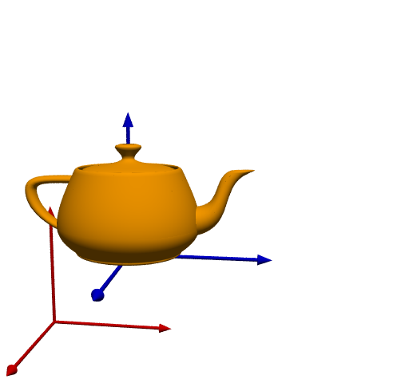
Translations
Translate points by adding offsets to their coordinates
The effect of this translation:

Slide 19
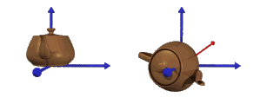
3D Rotations
More complicated than 2D rotations
  Rotate objects along a rotation axis
Several approaches
  Compose three canonical rotations about the axes
  Quaternions

Slide 20
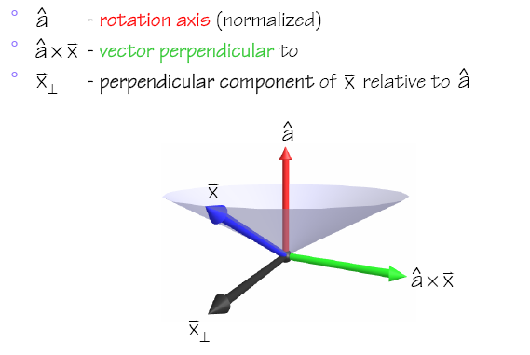
Geometry of a Rotation
Natural basis for rotation of a vector about a specified axis:

Slide 21
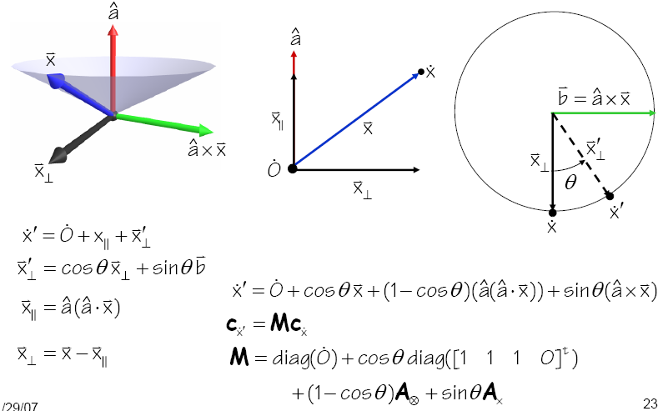
Geometry of a Rotation
Notes:
We need to assign O = (0, 0, 0, 1).
In general case, vector addition can be represented by translation matrix, not diagonal matrix.
We don’t need to normalize the vectors

Slide 22
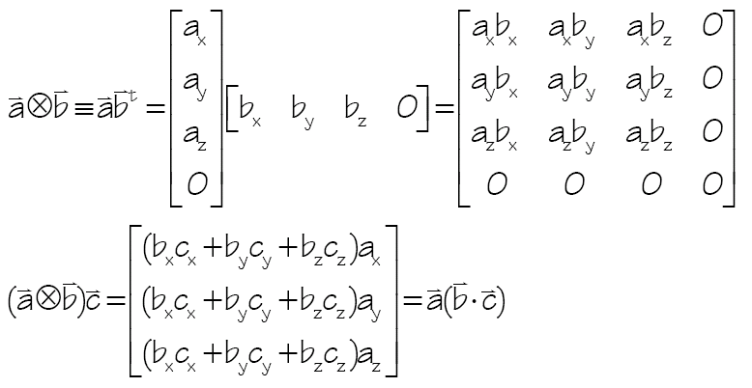
Tensor Product (⊗)
Creates a matrix that when applied to a vector return scaled by the project of onto

Slide 23
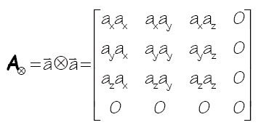
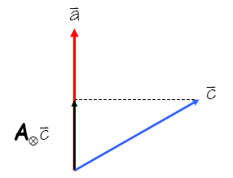
Tensor Product (⊗)
Useful when
The matrix is called the symmetric matrix of
  We shall denote this

Slide 24
Sanity Check
Consider a rotation by about the x-axis
You can check it in any computer graphics book, but you don’t need to memorize it

Slide 25
Rotation using Affine Transformation
Assume that these basis vectors are normalized

Slide 26
Quaternion
Developed by W. Hamilton in 1843
  Based on complex numbers
Two popular notations for a quaternion, q
  w + xi + yj + zk, where i²= j²= k²= ijk = -1
  [w, v], where w is a scalar and v is a vector
Conversion from the axis, v, and angle, t
  q = [cos (t/2), sin (t/2) v]
  Can represent rotation
Example: rotate by degree a along x axis:
q_{x} = [cos (a/2), sin(a/2) (1, 0, 0)]

Slide 27
Basic Quaternion Operations
Addition
  q + q´ = [w + w´, v + v´]
Multiplication
  qq´ = [ww´ - v · v´, v x v´ + wv´ +w´v]
Conjugate
  q* = [w, -v]
Norm
  N(q) = w² + x² + y²+ z²
Inverse
  q⁻¹ = q* / N(q)

Slide 28
Basic Quaternion Operations
q is a unit quaternion if N(q)= 1
  Then q⁻¹ = q*
Identity
  [1, (0, 0, 0)] for multiplication
  [0, (0, 0, 0)] for addition

Slide 29
Rotations using Quaternions
Suppose that you want to rotate a vector/point v with q
Then, the rotated v’
  v´ = q r q⁻¹, where r = [0, v])
Compositing rotations
  R = R2 R1 (rotation R1 followed by rotation R2)

Slide 30
Quaternion to Rotation Matrix
Q = w + xi + yj + zk
R_{m} =| 1-2y²-2z² 2xy-2wz 2xz+2wy|
| 2xy+2wz 1-2x²-2z² 2yz-2wx |
| 2xz-2wy 2yz+2wx 1-2x²-2y²|
We can also convert a rotation matrix to a quaternion

Slide 31
Advantage of Quaternions
More efficient way to generate arbitrary rotations
Less storage than 4 x 4 matrix
Easier for smooth rotation
Numerically more stable than 4x4 matrix (e.g., no drifting issue)
More readable

Slide 32
Class Objectives were:
Know the classic data processing steps, rendering pipeline, for rendering primitives
Understand 3D translations and rotations

Slide 33
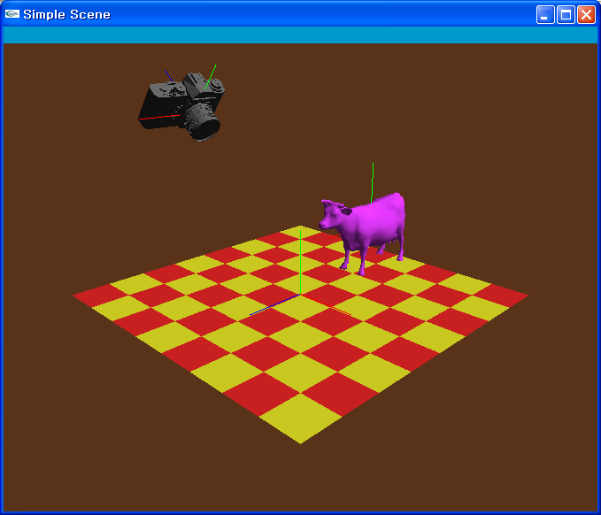
PA2: Simple Animation & Transformation

Slide 34
OpenGL: Display Lists
Display lists
  A group of OpenGL commands stored for later executions
  Can be optimized in the graphics hardware
  Thus, can show higher performance
  Ver. 4.3: Vertex Array Object is much better
Immediate mode
  Causes commands to be executed immediately

Slide 35
An Example
void drawCow()
{
if (frame == 0)
{
cow = new WaveFrontOBJ( "cow.obj" );
cowID = glGenLists(1);
glNewList(cowID, GL_COMPILE);
cow->Draw();
glEndList();
}
..
glCallList(cowID);
..
}

Slide 36
API for Display Lists
Gluint glGenLists (range)
- generate a continuous set of empty display lists
void glNewList (list, mode) & glEndList ()
: specify the beginning and end of a display list
void glCallLists (list)
: execute the specified display list

Slide 37
OpenGL: Getting Information from OpenGL
void main( int argc, char* argv[] )
{
…
int rv,gv,bv;
glGetIntegerv(GL_RED_BITS,&rv);
glGetIntegerv(GL_GREEN_BITS,&gv);
glGetIntegerv(GL_BLUE_BITS,&bv);
printf( "Pixel colors = %d : %d : %d\n", rv, gv, bv );
….
}
void display () {
..
glGetDoublev(GL_MODELVIEW_MATRIX, cow2wld.matrix());
..
}

Slide 38
Homework
Watch SIGGRAPH Videos
Go over the next lecture slides

Slide 39
Next Time
Viewing transformations
Notes:
1:30

