Slide 1
CS380: Computer Graphics
Interacting with a 3D World
Sung-Eui Yoon
(윤성의)
Course URL:
http://sglab.kaist.ac.kr/~sungeui/CG/
Notes:
1

Slide 2
Announcement
Mid-term exam
4:00pm ~ 5:40pm, Apr-22 (Tue.)

Slide 3
Class Objectives
Read a mesh representation
Understand a selection method and a virtual-trackball interface
Understand the modeling hierarchy

Slide 4
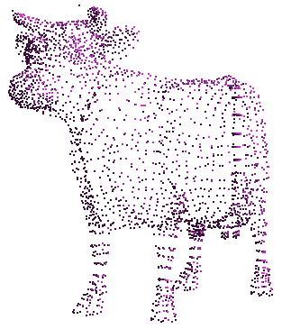
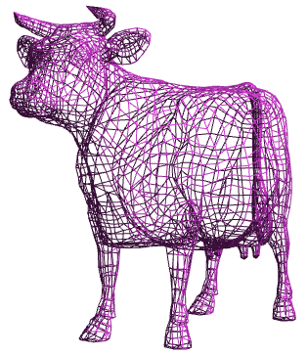
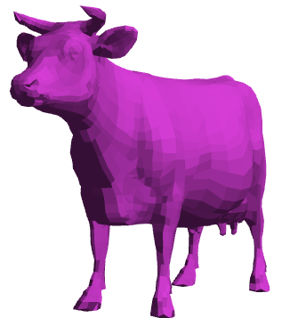
Primitive 3D
How do we specify 3D objects?
Simple mathematical functions, z = f(x,y)
Parametric functions, (x(u,v), y(u,v), z(u,v))
Implicit functions, f(x,y,z) = 0
Build up from simple primitives
Point – nothing really to see
Lines – nearly see through
Planes – a surface

Slide 5
Simple Planes
Surfaces modeled as connected planar facets
N (>3) vertices, each with 3 coordinates
Minimally a triangle

Slide 6
Specifying a Face
Face or facet
Face [v0.x, v0.y, v0.z] [v1.x, v1.y, v1.z] … [vN.x, vN.y, vN.z]
Sharing vertices via indirection
Vertex[0] = [v0.x, v0.y, v0.z]
Vertex[1] = [v1.x, v1.y, v1.z]
Vertex[2] = [v2.x, v2.y, v2.z]
:
Vertex[N] = [vN.x, vN.y, vN.z]
Face v0, v1, v2, … vN
v₃
v₀
v₂
v₁

Slide 7
Vertex Specification
Where
Geometric coordinates [x, y, z]
Attributes
Color values [r, g, b]
Texture Coordinates [u, v]
Orientation
Inside vs. Outside
Encoded implicitly in ordering
Geometry nearby
Often we’d like to “fake” a more complex shape than our true faceted (piecewise-planar) model
Required for lighting and shading in OpenGL

Slide 8
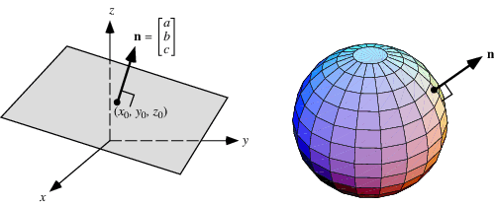
Normal Vector
Often called normal, [n_{x}, n_{y}, n_{z}]
Normal to a surface is a vector perpendicular to the surface
Will be used in illumination
Normalized:

Slide 9
Drawing Faces in OpenGL
glBegin(GL_POLYGON);
foreach (Vertex v in Face) {
glColor4d(v.red, v.green, v.blue, v.alpha);
glNormal3d(v.norm.x, v.norm.y, v.norm.z);
glTexCoord2d(v.texture.u, v.texture.v);
glVertex3d(v.x, v.y, v.z);
}
glEnd();
Heavy-weight model
Attributes specified for every vertex
Redundant
Vertex positions often shared by at least 3 faces
Vertex attributes are often face attributes (e.g. face normal)

Slide 10
Decoupling Vertex and Face Attributes via Indirection
Works for many cases
Used with vertex array or vertex buffer objects in OpenGL
Exceptions:
Regions where the surface changes materials
Regions of high curvature (a crease)

Slide 11
3D File Formats
MAX – Studio Max
DXF – AutoCAD
Supports 2-D and 3-D; binary
3DS – 3D studio
Flexible; binary
VRML – Virtual reality modeling language
ASCII – Human readable (and writeable)
OBJ – Wavefront OBJ format
ASCII
Extremely simple
Widely supported

Slide 12
OBJ File Tokens
File tokens are listed below
# some text
Rest of line is a comment
v float float float
A single vertex’s geometric position in space
vn float float float
A normal
vt float float
A texture coordinate

Slide 13
OBJ Face Varieties
f int int int ... (vertex only) or
f int/int int/int int/int . . . (vertex & texture)
or
f int/int/int int/int/int int/int/int … (vertex, texture, & normal)
The arguments are 1-based indices into the arrays
Vertex positions
Texture coordinates
Normals, respectively

Slide 14
OBJ Example
# A simple cube
v 1 1 1
v 1 1 -1
v 1 -1 1
v 1 -1 -1
v -1 1 1
v -1 1 -1
v -1 -1 1
v -1 -1 -1
f 1 3 4
f 5 6 8
f 1 2 6
f 3 7 8
f 1 5 7
f 2 4 8
Vertices followed by faces
Faces reference previous vertices by integer index
1-based

Slide 15
OBJ Sources
Avalon – Viewpoint (http://avalon.viewpoint.com/) old standards
3D Café – (http://www.3dcafe.com/asp/meshes.asp) Nice thumbnail index
Others
Most modeling programs will export .OBJ files
Most rendering packages will read in .OBJ files

Slide 16
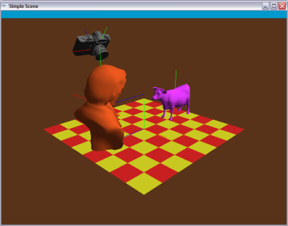
Picking and Selection
Basic idea: Identify objects selected by the user
Click-selection: select one object at a time
Sweep-selection: select objects within a bounding rectangle
Demo
(click h)

Slide 17
Picking and Selection
Several ways to implement selection:
Find screen space bounding boxes contained in pick region
Compute a pick ray and ray trace to find intersections
OpenGL selection buffers
Render to back buffer using colors that encode object IDs and return ID under pick point

Slide 18
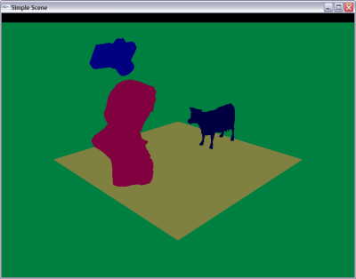
Selection with the Back Buffer
Selects only objects that are visible
Render objects to back buffer with color that encodes ID
Use glReadPixels() to read the pixel at the pick point
Back buffer is never seen

Slide 19
An Example of Reading the Back Buffer
void onMouseButton(int button, int state, int x, int y)
{ ...
if (button == GLUT_LEFT_BUTTON && state == GLUT_DOWN)
{
printf( "Left mouse click at (%d, %d)\n", x, y );
selectMode = 1;
display();
glReadBuffer(GL_BACK);
unsigned char pixel[3];
glReadPixels(x, y, 1, 1, GL_RGB, GL_UNSIGNED_BYTE, pixel);
printf( "pixel = %d\n", unmunge(pixel[0],pixel[1],pixel[2]));
selectMode = 0;
}
…
}

Slide 20
Buffer Operations in OpenGL
Still supported in OpenGL 4.3
glReadBuffer (mode)
GL_FRONT, GL_BACK, etc.
glReadPixels(x, y, w, h, pixel_format, data_type, * buffers)
Pixel_format: GL_RGB, GL_RGBA, GL_RED, etc.
Data_type: GL_UNSIGNED_BYTE, GL_FLOAT, etc.
Other related APIs
glDrawPixels

Slide 21
Interaction Paradigms
Can move objects or camera
Object moving is most intuitive if the object “sticks” to the mouse while dragging

Slide 22
Interaction Paradigms
Move w.r.t. to camera frame
Pan – move in plane perpendicular to view direction
Dolly – move along the view direction
Zoom - looks like dolly: objects get bigger, but position remains fixed
Rotate
up/down controls elevation angle
left/right controls azimuthal angle
Roll – spin about the view direction
Trackball – can combine rotate and roll

Slide 23
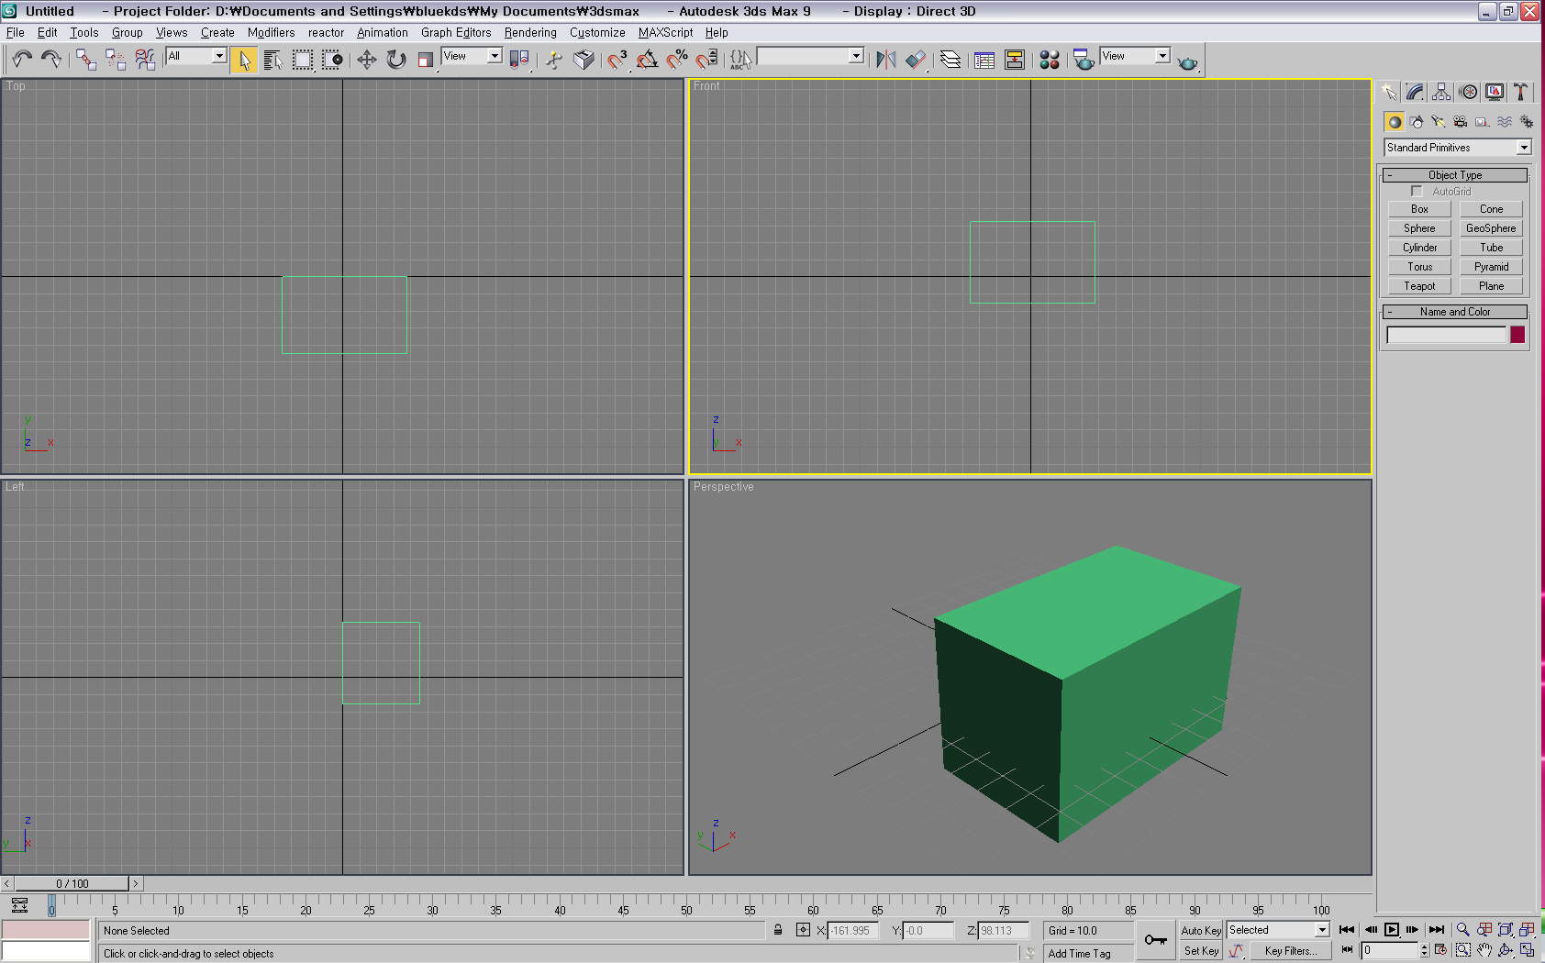
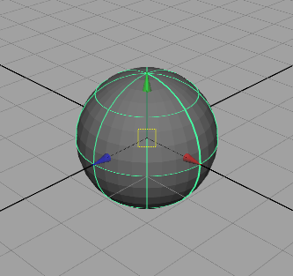
Interaction Paradigms
Move w.r.t to modeling (or world) frame
Maya combines both
Presents a frame where you can drag w.r.t the world axes
Dragging origin moves w.r.t. to camera frame

Slide 24
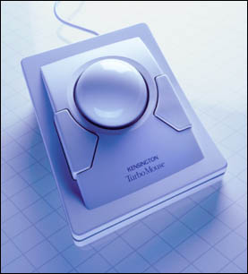
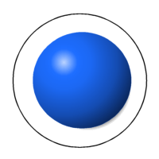
Interaction - Trackball
A common UI for manipulating objects
2 degree of freedom device
Differential behavior provides a intuitive rotation specification
Trackball demo

Slide 25
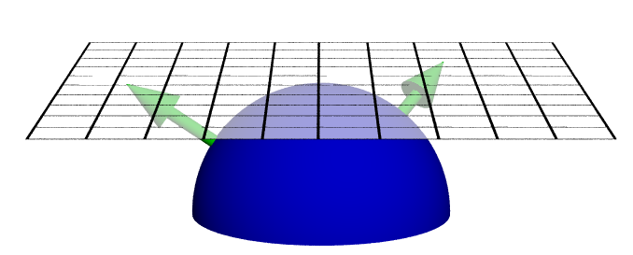
A Virtual Trackball
Imagine the viewport as floating above, and just touching an actual trackball
You receive the coordinates in screen space of the MouseDown() and MouseMove() events
What is the axis of rotation?
What is the angle of rotation?

Slide 26
Computing the Rotation
Construct a vector from the center of rotation of the virtual trackball to the point of the MouseDown() event
Construct a 2nd vector from the center of rotation for a given MouseMove() event
Normalize , and , and then compute
Then find the and construct

Slide 27
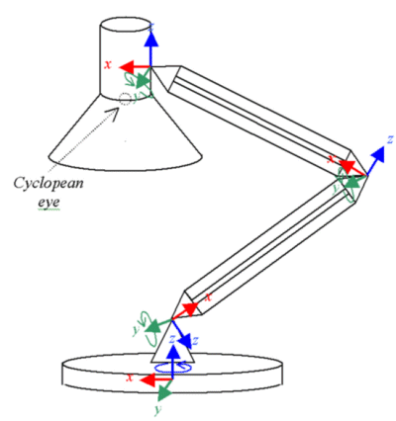
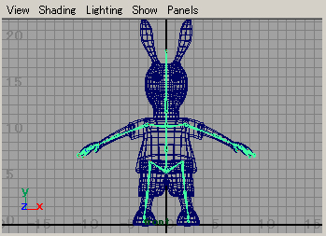
Transformation Hierarchies
Many models are composed of independent moving parts
Each part defined in its own coordinate system
Compose transforms to position and orient the model parts
A simple “One-chain” example
http://www.imanishi.com

Slide 28
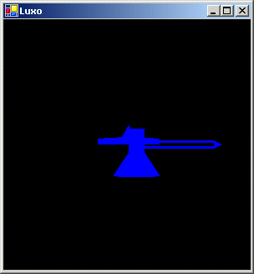
Code Example (Take One)
public void Draw() {
glClear(GL_COLOR_BUFFER_BIT | GL_DEPTH_BUFFER_BIT);
glLoadIdentity();
gluLookat(0, 0,-60, 0,0,0, 0,1,0); // world-to-camera transform
glColor3d(0,0,1);
glRotated(-90, 1, 0, 0); // base-to-world transform
Draw(Lamp.BASE);
Draw(Lamp.BODY);
Draw(Lamp.NECK);
Draw(Lamp.HEAD);
glFlush();
}
Notes:
In glMatrixMode, the initial value is GL_MODELVIEW

Slide 29
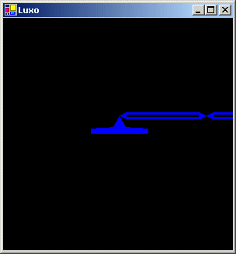
Code Example (Take Two)
public void Draw() {
glClear(GL_COLOR_BUFFER_BIT | GL_DEPTH_BUFFER_BIT);
glLoadIdentity();
glTranslated(0.0, 0.0, -60.0); // world-to-view transform
glColor3d(0,0,1);
glRotated(-90, 1, 0, 0); // base-to-world transform
Draw(Lamp.BASE);
glTranslated(0,0,2.5); // body-to-base transform
Draw(Lamp.BODY);
glTranslated(12,0,0); // neck-to-body transform
Draw(Lamp.NECK);
glTranslated(12,0,0); // head-to-neck transform
Draw(Lamp.HEAD);
glFlush();
}

Slide 30
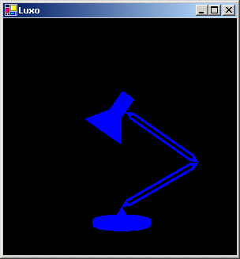
Code Example (Take Three)
public void Draw() {
glClear(GL_COLOR_BUFFER_BIT | GL_DEPTH_BUFFER_BIT);
glLoadIdentity();
glTranslated(0.0, -12.0, -60.0); // world-to-view transform
glColor3d(0,0,1);
glRotated(-90, 1, 0, 0); // base-to-world transform
Draw(Lamp.BASE);
glTranslated(0,0,2.5); // body-to-base transform
glRotated(-30, 0, 1, 0); // rotate body at base pivot
Draw(Lamp.BODY);
glTranslated(12,0,0); // neck-to-body transform
glRotated(-115, 0, 1, 0); // rotate neck at body pivot
Draw(Lamp.NECK);
glTranslated(12,0,0); // head-to-neck transform
glRotated(180, 1, 0, 0);// rotate head at neck pivot
Draw(Lamp.HEAD);
glFlush();
}

Slide 31
Class Objectives were:
Read a mesh representation
Understand a selection method and a virtual-trackball interface
Understand the modeling hierarchy

Slide 32
Program Assignment 4
Use the previous skeleton codes

Slide 33
Reading Assignment
Read Chapter “A Full Graphics Pipeline”

Slide 34
Figs

Slide 35
$$M_{p}$$
$$M_{b}$$
$$M_{b}$$
: transform from the base to the world
$$M_{p}$$
: transform from the part to the base

